Slide 1
PRESENTS
A Community of People Readers: Meaningful Picture Books and
Their Social Emotional Learning Value
for the 2013 Social Emotional Learning Conference
Presented by Metropolitan Nashville Public Schools In Partnership with Alignment Nashville
Materials developed by Bringing Books to Life!

Slide 2
The beauty of an early childhood picture book is how it brings what is most important into focus with so few words. Having long been used in bedrooms, classrooms and therapy rooms as a tool for helping children and adults connect with their feelings, the picture book genre is a rich resource for introducing social emotional learning concepts.
What lies between the pages of these works of art and language helps children develop in optimal ways. By empathizing with a characters’ struggles, strengthening decision making through pretend trial and error, and identifying their own inherent means of self-motivation and self-control, children are brought in close proximity to life’s everyday demands.
Some people learn more from a story than anything else. While for others a picture represents a thousand words. Putting these together into a picture book makes it a powerful means of reaching and teaching.

Slide 3
At Bringing Books to Life we’d love to hear from you about any connections that you make with the books, how you engage them around social emotional learning competencies and common core utility.
For more information on the
Nashville Public Library’s Bringing Books to Life! program
please visit nashvillepubliclibrary.org/bringingbookstolife/
This website is cherished by teachers, families, librarians and literacy enthusiasts for its book reviews, titles and lists, articles on issues relevant to early childhood development, and ideas on engaging with children’s literature and literacy. It is full of information to making reading even more of a joy than it already is, if you can imagine that.
If you have a favorite site that you think would be interested in placing a link to ours, we’d love to know about it. Just contact:
615 Church Street, Nashville, TN 37219
615-862-5804, x5757
emily.green-cain@nashville.gov

Slide 4
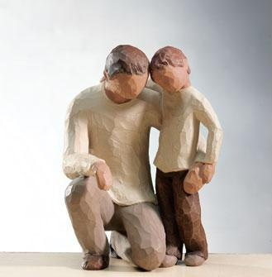
Who Reads Johnny? By Gerhard E. Frost
I knew a tall man once
who endeared himself to children
because he took them seriously.
He respected them as persons
and proved it by reaching down to their level.
I mean this, literally;
he would stoop down, kneeling sometimes
to look into their eyes
and to really hear them.
He played with them,
but never as toys,
for he knew that no person is ever a toy.
In education, as in all human relationships,
the question is not so much,
why Johnny can’t read
as, who reads Johnny?
…Love’s library is people;
it reads the individual
and aims to see and understand
each person, one by one.
If we care we will be alert
to mood and feelings.
We will know that our reading assignment,
as teachers or parents,
is that living, feeling,
learning person.
In more ways than one,
life’s most important task
is to learn to read.

Slide 5
As a way of warming up your voice and your self-awareness,
try saying out loud a nursery rhyme, a book passage
or even a song lyric with one of these FEELING WORDS.
This is good to do alone, with colleagues and of course, students.

Slide 6
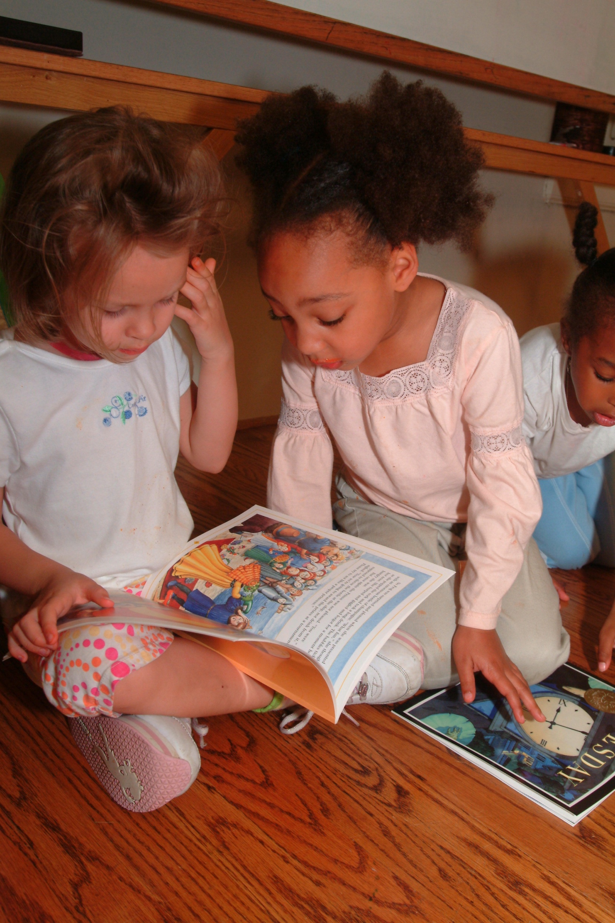
The next pages are filled with book titles that you might enjoy trying out. Most of them are written for a young child audience, though when read with feeling and an openness for discussion, older children, and even adults, also find them meaningful. The greatness of children’s picture books is how they speak to people of all ages.
The list ahead is categorized by topic and naturally, like life, there is overlap. Some books listed under sadness can be used just as well to talk about worry and those under differences could just as easily come under mad. Choosing a picture book is like choosing a friend – spend time with it and see how it makes you feel.

Slide 12
Families and Loving
Always by Ann Stott
Are You My Mother? by P.D. Eastman and Carlos Rivera (Ages infant-5)
Baby Dance by Ann Taylor (Ages infant-4)
Because I Love You So Much by Guido van Genechten (Ages 2-5)
Counting Kisses by Karen Katz (Ages infant-5)
Do You Know What I’ll Do? by Charlotte Zolotow
Don’t Forget I Love You by Miriam Moss (Ages 2-7)
Full, Full, Full of Love by Trish Cooke (Ages 4-6)
Guess How Much I Love You By Sam McBratney (Ages infant-5)
Honey Baby Sugar Child by Alice Faye Duncan (ages infant – 5)
How Do I Love You? by P.K. Hallinan (Ages infant-5)
Hug by Jez Alborough (Ages infant-5)
I Love it When You Smile by Sam McBratney (Ages 3-5)
I Love You All Day Long by Francesca Rusackas (Ages 3-5)
I Love You: A Rebus Poem, by Jean Marzollo (Ages 1-6)
I Love You the Purplest, by Barbara M. Joose (Ages 4-8)
I Love You Through and Through by Bernadette Rossetti-Shustak (Ages 1-5)
Koala Lou By Mem Fox (Ages 4-7)
Mama, Do You Love Me?/Me quieres, mama? By Barbara Joosse (Ages 3-6)
More, More, More, Said the Baby by Vera B. Williams (Ages infant-3)
My Nana and Me by
My Pop Pop and Me
No Matter What by Debi Gliori (Ages 2-5)
Please, Baby, Please by Spike Lee (Ages infant-5)
Te Amo Bebe, Little One by Lisa Wheeler (Ages infant-3)
The Kissing Hand by Audrey Penn (Ages 3-8)
The Middle-Child Blues by Kristyn Crow (ages 4-8)
When You Are Happy by Eileen Spinelli (Ages 3 -8)
You’re All My Favorites by Sam Mc Bratney (Ages 5-7)

Slide 13
Behavior Expectations
Can You Listen with Your Eyes? by Nita Everly (3-6)
Can You Use a Good Voice? by Nita Everly (3-6)
David Gets in Trouble by David Shannon (Ages 3-8)
David Goes to School by David Shannon (Ages 3-8)
Excuse Me!: A Little Book of Manners by Karen Katz (Ages infant-5)
Hands by Virginia Kroll (Ages 2-5)
Hands Can by Cheryl Willis Hudson (ages 1-5)
Helping Out by George Ancona (Ages 4-8)
How do Dinosaurs…(series) by Jane Yolen (Ages 3 – 6)
No Biting by Karen Katz (Ages infant-5)
No David by David Shannon (Ages 3-8)
No Hitting by Karen Katz (Ages infant-5)
Please Play Safe! Penguin’s Guide to Playground Safety by Margery Cuyler (Ages 2-5)
Reach Out and Give by Cheri Meiners
Words Are Not for Hurting by Elizabeth Verdick (Ages 3-6)
Yes, No, Maybe So by Charise Mericle (ages 4 – 7)

Slide 15
Sad Feelings
Franklin’s Bad Day by Paulette Bourgeois & Brenda Clark (5-8)
Goodbye Mousie by Robert Harris (3-8)
How I Feel Sad by Marcia Leonard (2-6)
Hurty Feelings by Helen Lester (5-8)
I Miss You by Pat Thomas (4-8)
Knuffle Bunny by Mo Willems (3-6)
Let’s Talk About Feeling Sad by Joy Wilt Berry (3-5)
My Father’s Arms Are a Boat by Stein Erik Lunde (4 and up)
Sad Isn’t Bad: Grief Guidebook for Kids Dealing with Loss Series by Michaelene Mundy (5-8)
Sometimes I Feel Awful by Joan Singleton Prestine (5-8)
The Fall of Freddie the Leaf by Leo Buscaglia (5-adult)
The Next Place by Warren Hanson (5-adult)
The Red Tree by Shaun Tan (4 and up)
The Very Lonely Firefly by Eric Carle (4-7)
When I Feel Sad by Cornelia Maude Spelman (5-7)
When I’m Feeling Sad by Trace Moroney (2-5)
You Hold Me and I’ll Hold You by Jo Carson (4-8)

