Slide 1
WELCOME
What is MOVE 2 STAND
Eric Johnson, Jeannie Carr Connelly & Matt
Gress

Slide 2

Building Community and Engaging High School Students in Bullying Prevention

Slide 3
Tennessee Definitions
Bullying
“Bullying” is conduct that meets one or more of the following criteria:
  is an act directed at one or more students that is intended to harm or embarrass;
  is repeated over time; and
  involves an imbalance of physical, emotional, or social power.

Slide 4
The History:
School Shootings in Tennessee
1994 – Nashville, TN
1995 - Lynnville, TN
1998 – Fayetteville, TN
2005 - Cumberland County, TN
2005 – Jacksboro, TN
2007 Memphis, TN
2008 – Memphis, TN (2 shootings in 7 days)
2008 – Knoxville, TN

Slide 5
The Moment it STARTED

Slide 6
Tragedy Strikes Hardin County High School
01/24/07
SAVANNAH, TN -- A 17-year-old student at Hardin County High School is in critical condition at a Memphis hospital after suffering an apparent self-inflicted gunshot wound. The victim entered a restroom in the school where he shot himself. Police have not yet determined if the shooting was accidental or a suicide attempt. The school was placed in Lockdown and about 750 students were picked up early by their parents. A week earlier, a man shot and wounded his wife then killed himself in the parking lot across the street from the High School. The school has been in the process of tightening security.

Slide 7
School Climate
“School Climate is like the air we breathe; you don’t really notice it until it becomes toxic.”
H. Jerome Freiberg
Notes:
7

Slide 8
Culture & Climate
Webster* defines culture as “ways of living set up by a human group and transmitted to a succeeding generation.” “Ways of living,” or “The way we do things here,” as set up by groups.
So, climate is ‘how it feels to be here,’ and culture is ‘how we do things here.’ Adults establish the parameters of a school’s climate. School culture develops in the contest of climate in a continuously interactive process.

Slide 9
“We had kind of forgotten about having relationships with kids … and we paid a high price.”
Jerry McAdams

Slide 10
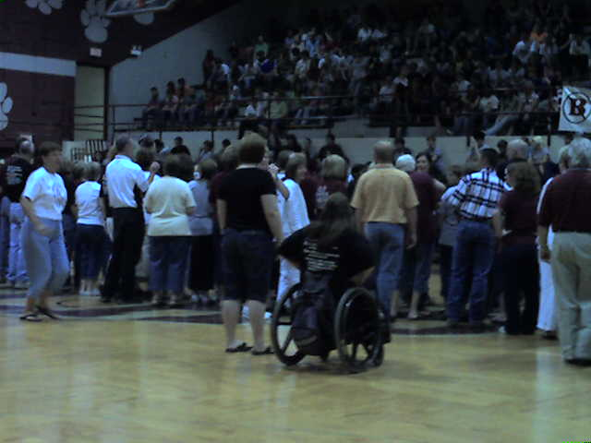
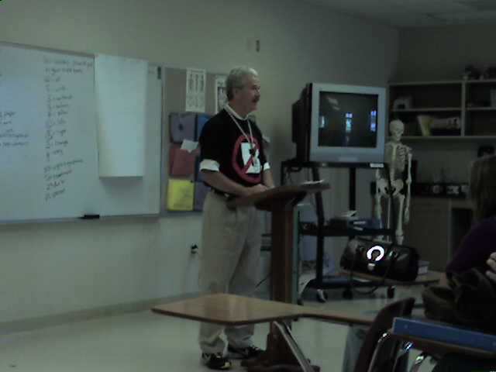
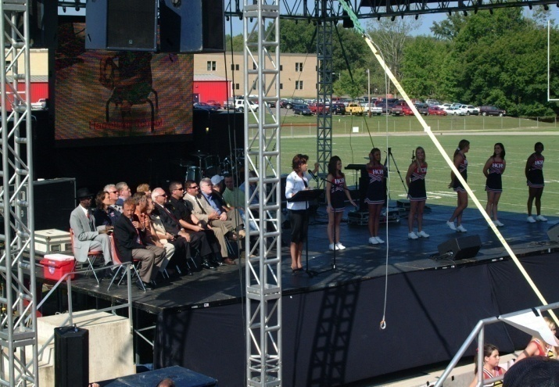
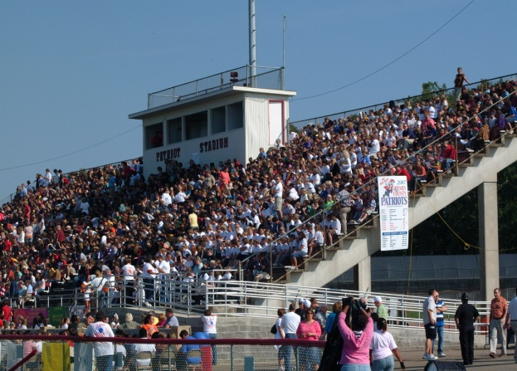
Shining Examples
Hardin County
Henry County

Slide 11
School climate refers to the character and quality of school life.
It is based on patterns of people’s experience of school life and reflects*:
• norms, goals, values
• interpersonal relationships
• teaching, learning
• leadership practices
• organizational structures.
National School Climate Council

Slide 12
Jocks Against Bullying
Selena Roberts
Sports Illustrated, July 07, 2008
"All the jocks stand up."
Words allegedly uttered by Eric Harris and Dylan Klebold as they began a shooting rampage at Columbine High School, leaving 15 dead on April 20, 1999
"Those motherf------ jocks."
Passage in the online diary of Kimveer Gill, discovered after he opened fire at Dawson College in Montreal, killing one and injuring 19 before killing himself on Sept. 13, 2006

Slide 13
Jocks Against Bullying,
Selena Roberts
Sports Illustrated, July 07, 2008
JESUS SALAVAR (played wide receiver and cornerback at Del Mar High) can spot the outcasts. They walk carefully enough not to bump anyone—not to draw any stares—as they try to slip through the low-slung hallways of Del Mar High in San Jose. There is a look the vulnerable possess: haunted. You see the faces, and you see the expressions," says Salavar. "It makes you wonder, Is it happening to them?" Did they receive the text message about the hot girl who likes them only to find out it was a hoax? Did someone create a phony social networking profile of them that lists their turn-ons as Star Wars and animal porn?”

Slide 14
Michele Livingstone is a swimmer Branham High, located in the same Silicon Valley as Del Mar High
Empathy isn't always a staple of the popular crowd, but the likable Livingstone, bubbly to the point of being carbonated, is turning 17 this week with the kind of perspective some adults don't possess.
"Something simple—like saying hello—can change so much for someone who feels isolated," Livingstone says. "It's like they can say to themselves, O.K., not everyone hates me."

Slide 15

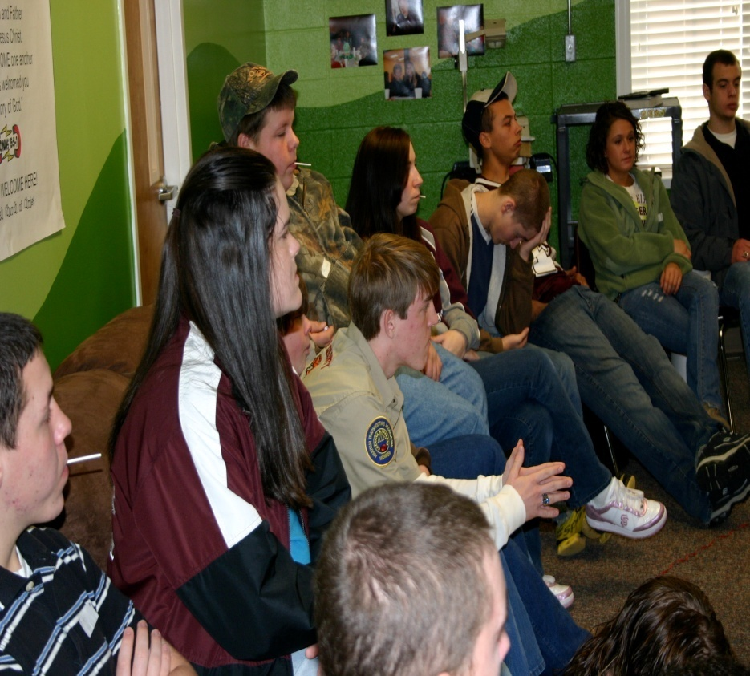
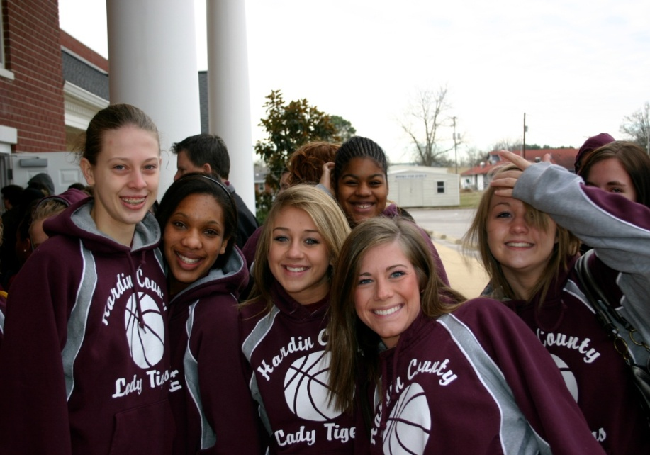

Slide 16

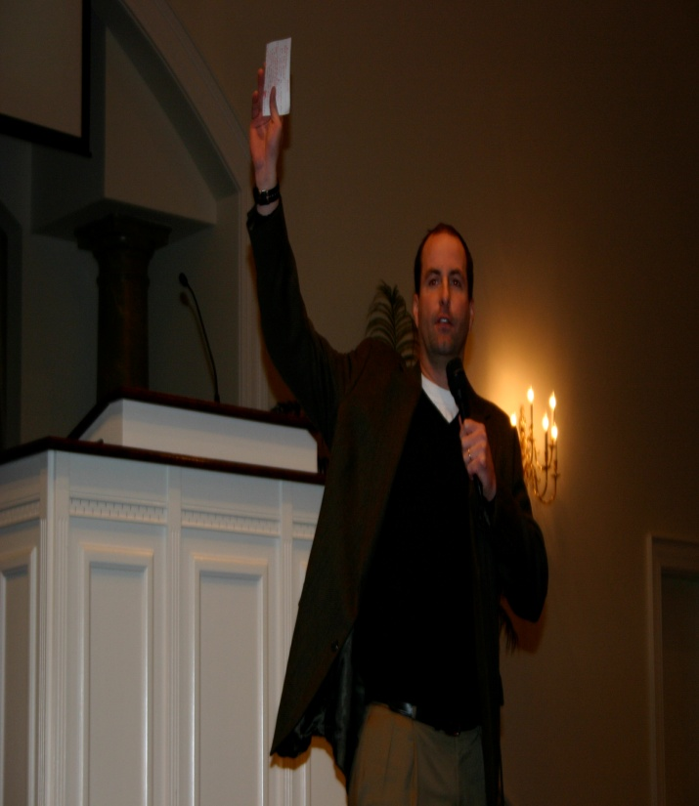
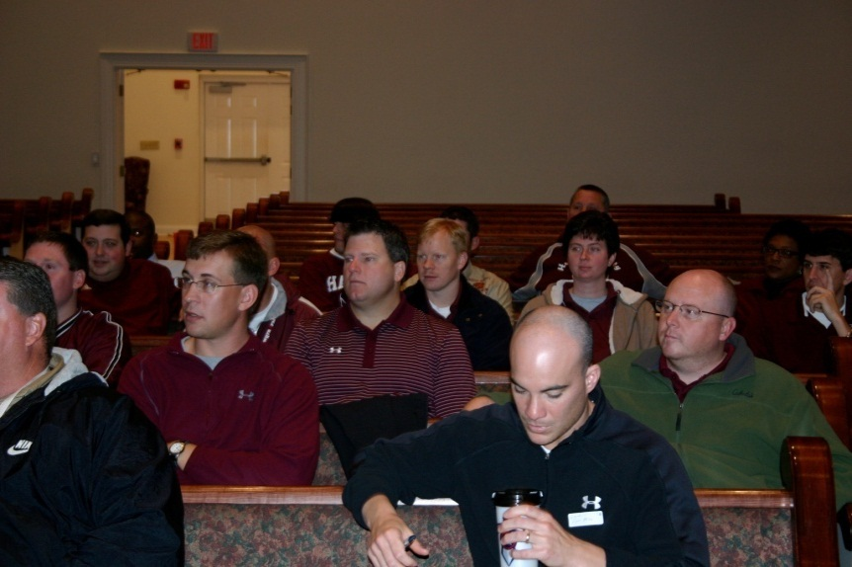
Will challenge the Student Athlete and Leader to examine their attitudes and give in an effort to help them better understand how bullying impacts school climate. This powerful summit will force participants to look at the many hidden similarities which exist among a diverse population of students.
Clinic is held concurrently with the Youth Development Summit.

Slide 17
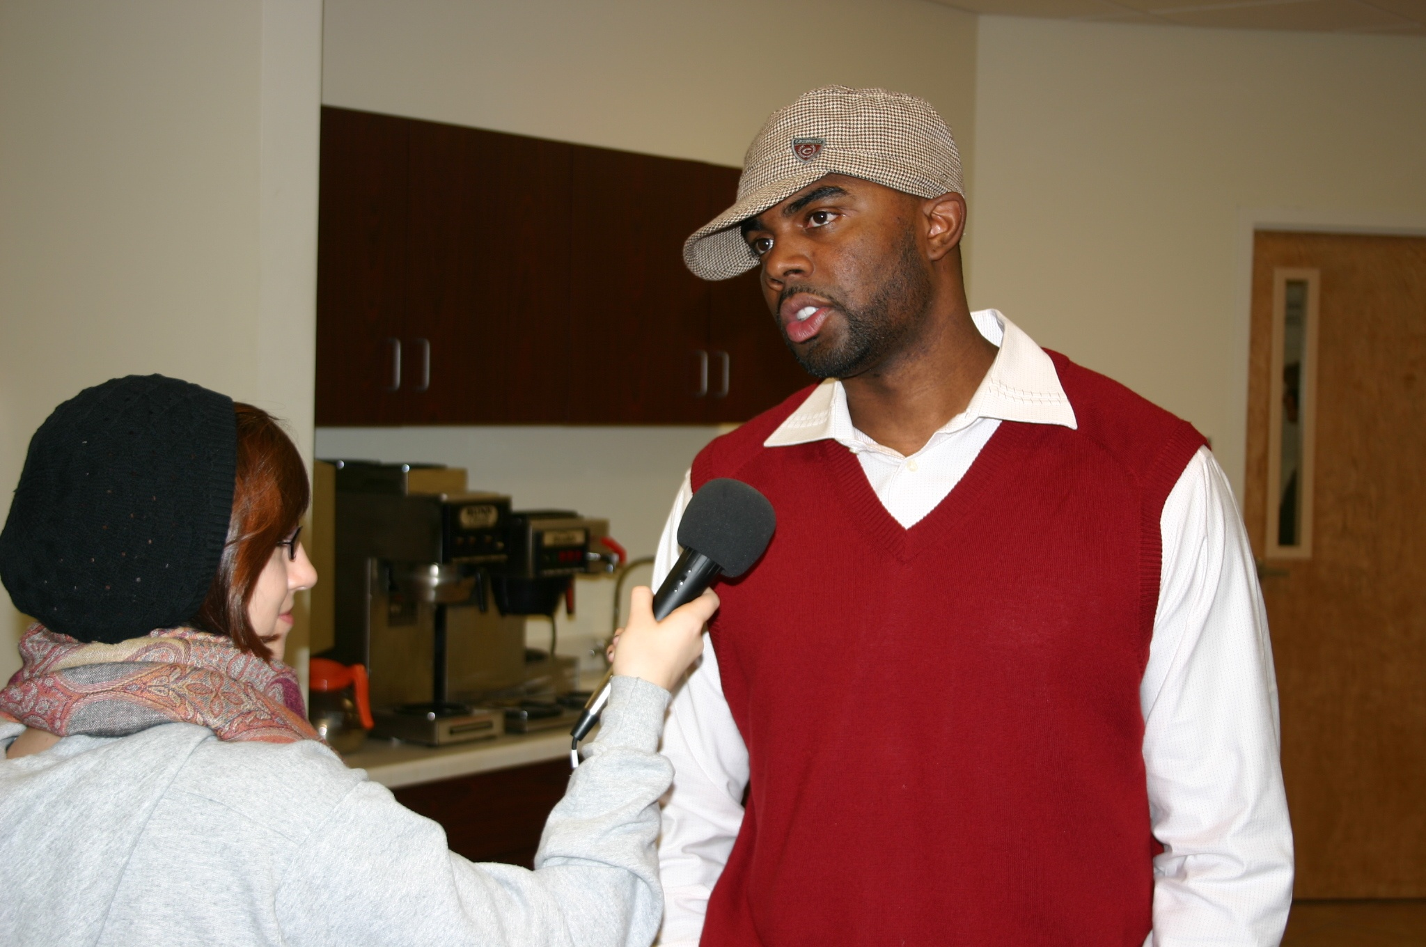

Slide 18

The Big Picture
A powerful one day Youth Development summit geared toward athletes and other leaders in the school.
Focused topics include:
Bullying/Harassment
Conforming/Leadership
Empowering By-Standers
Finding the Assets in You
Building/Creating Empathy

Slide 19

*a program of S.T.A.R.S.

Slide 20
“The mission of education is to teach students to be both smart and good.”
Socrates

Slide 21
“Ability may get you to the top, but it takes character to keep you there.”
John Wooden

Slide 22
Character
Our Character is much more than just what we try to display for others to see, it is who we are even when no one is watching.
Good character is doing the right thing because it is right to do what is right.

Slide 23
Student Success, School Improvement and Student Attachment to School are predicated on solid relationships.
The result is Student Connectedness

Slide 24
School Attachment
Students are more likely to succeed when they feel connected to school. School Connection is the belief by students that adults in the school care about their learning as well as about them as individuals.
Notes:
When this is present it helps create the Rule of 5

Slide 25
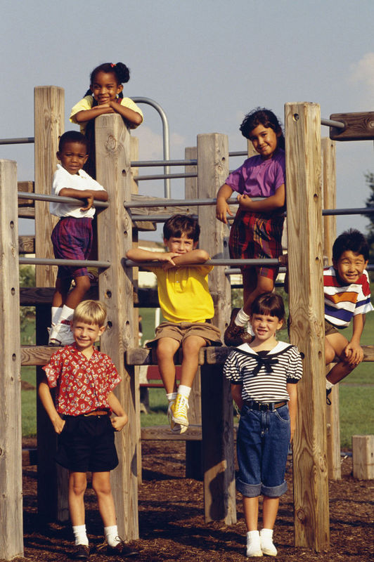
In a truly “Safe School,” every student feels that …
They belong.
They are valued.
They are physically and emotionally safe.

Slide 26
What is Move To Stand?
The Move2Stand program is a workshop designed to successfully address some of the common issues that many schools experience through, bullying, harassment, racism, cliques, violence, stereotyping other social pressures that teens face today.

Slide 27
Move 2 Stand is a powerful one-day six hour youth development training geared toward challenging students athletes and student leaders to examine their attitudes and beliefs in an effort to help them better understand how bullying effects their school climate and what they can do about it. Move 2 Stand will provide all participants the opportunity to look at the hidden similarities that exist within a diverse student population.

Slide 28
Things you should know about bullying and harassment

Slide 29
What is Bullying?
Bullying is when someone repeatedly and on purpose says or does mean or hurtful things to another person who has a hard time defending him/herself. This definition also includes three important components:
Bullying involves aggressive behavior.
Bullying typically involves a pattern of behavior repeated over time.
An imbalance of power and strength exists. This imbalance could be physical, emotional, social, and economical in nature.

Slide 30
How Do People Bully?
1. Direct (hitting, kicking, shoving, spitting, taunting, name calling, degrading comments)
2. Indirect (spreading rumors, social isolation, cyber-bullying, getting another person to bully someone)

Slide 31
Who Bullies?
Both male and female
Normally want control
Although it is often thought that only students with low self esteem bully in an effort to make themselves feel better, research has found that both students with high and with low self esteem bully (Olweus 1993)

Slide 32
Who Bullies? (Continued)
Normally do not feel empathy for those they are bullying
Often have many friends and would not be labeled as “loners”. In fact, they usually gain popularity and prestige because of their behaviors
Usually do fine academically in school
Usually have more power (i.e. more status, popularity and sometimes size) than those they bully

Slide 33
Who Bullies? (Continued)
Not surprisingly, often come from homes where bullying behaviors are practiced
Unfortunately, they have a much greater chance of engaging in criminal acts later in life. Research indicates that 6 in 10 will have at least one criminal offense by age 24. Further, 3 in 10 will have multiple criminal offenses by age 24. (Olweus et al. 2007)

Slide 34
Who Gets Bullied?
Often loners
Often shy and unable to stand up to those who bully
Often do not report because they do not trust adults to actually do anything to stop it
Often have health issues such as headaches, sleep problems, anxiety and depression
Sometimes skip school because of fear or anxiety
Sometimes find it easier to associate with adults than peers

Slide 35
Bystanders
Watch a bullying incident and do not intervene
Often want to help but do not know how
Find themselves supporting the bully by laughing, even though they do not agree with bullying
Can be key in changing school climate

Slide 36
Where And When Does Bullying Happen?
Hallways
In class (with or without the teacher)
In gym or locker rooms
Lunchroom
Bathroom
On the bus

Slide 37
Why Does Bullying Happen?
Discussion:
What factors encourage a climate of bullying?
Why don't kids report?
Why don't kids stand up for others is bullying situations?

Slide 38
Important Numbers
Children who bully and those who are bullied make up approximately 25-30% of the student body. (Olweus Bully Prevention Group 2010)
Approximately 70-75% of the student body is not directly involved in bullying, but are bystanders. (Bullying in the U.S.; “Are we making the Grade”, Oct. 20, 2010)

Slide 39
THE SOCIAL EMOTIONAL LEARNING CONNECTION

Slide 40
Social and emotional learning (SEL) programming can be an effective way to reduce the likelihood of bullying because it promotes skills, behaviors, attitudes, and environmental factors that are incompatible with bullying and other forms of negative peer interactions.

Slide 41
What Does the Research Say About SEL and Bullying?
Research clearly indicates that bullying cannot flourish in a safe and caring learning environment characterized by:
Supportive relationships between teachers and students and among students that encourage open communication and positive ways to resolve problems and conflicts.
Good working relationships between schools and families that foster two-way communication about student growth and development.
School norms, values, and policies that emphasize respect for others and appreciation of differences.
Students who are aware of and can manage their emotions, demonstrate caring and concern for others, establish positive relationships, make responsible decisions, and handle challenging social situations constructively.

Slide 42
Academic Impact
A Landmark Review found that students who receive SEL instruction had more positive attitudes about school and improved an average of 11 percentile points on standardized achievement tests compared to students who did not receive such instruction.

Slide 43
A Quick Look at Prevention Research
The greatest risk factors for children and adolescents are:
Getting into academic and behavioral trouble at school
Lack of strong, positive relationships with adults
Hanging out with kids who are engaging in risky behaviors

Slide 44
2. The greatest protection factors for children and adolescents are:
Positive, healthy relationships with peers
Positive attachment to school and learning
Positive relationships with adults
3. Acquiring a new skill or changing a behavior requires 6 to 8 hits that include introduction and exposure to the skill or behavior, practice, coaching, and feedback, applications in multiple contexts, and demonstration of mastery.

Slide 45
4. Promoting healthy development (meeting students’ needs for safety, belonging and attachment, respect, recognition, identity, choice and voice, mastery, and meaningful participation) is the foundation fro helping students to become more socially and emotionally competent.
5. Effective schools create a seamless system of discipline, academic and behavioral support, and physical and mental health services for children and families.

Slide 46
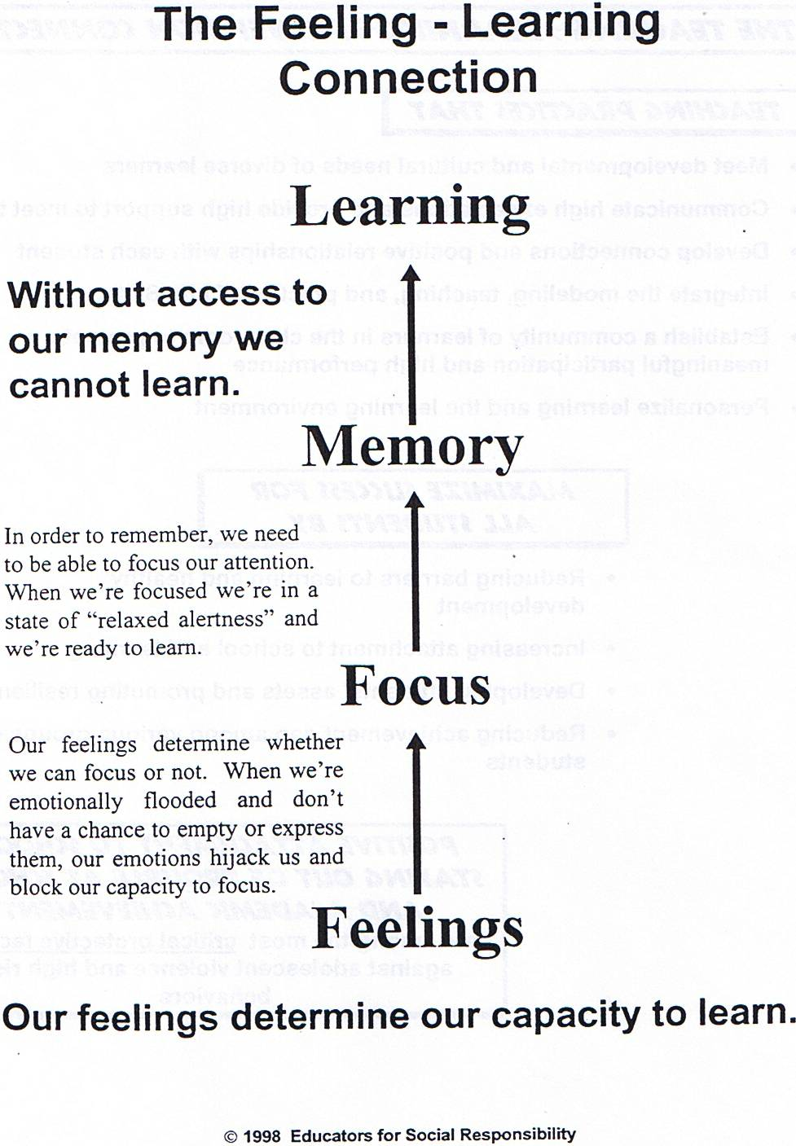

Slide 47
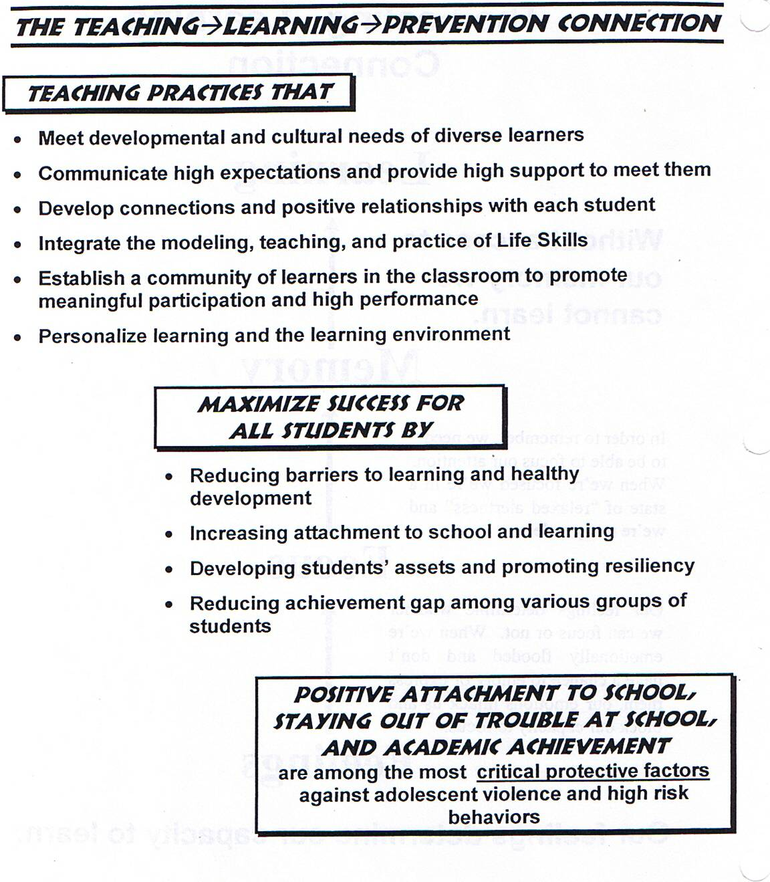

Slide 48
All educators are cultural transmitters and agents of socialization. The question is……
Whose culture and What kind of socialization?

Slide 49
The
Move To Stand
Workshop

Slide 50
Choosing Participants
Move 2 Stand can either be led specifically for student athletes or for all students with leadership potential, including student athletes.

Slide 51
When Choosing Participants, Remember...
Must represent all areas of school’s athletic teams (baseball, football, basketball, soccer, tennis, wrestling, swimming, cheerleading, dance squads, bowling, and any other sports)
• male and female (all grade levels)
• racial and ethnic diversity
• diverse socio-economic backgrounds
• without serious discipline problems

Slide 52
Did you know …
In Tennessee 60% of students say that they try to help when they see someone being bullied?
That in most schools more than 94% of all students report that when one of their peers is being bullied that they think that they feel sorry or at least a bit sorry and want to help?
There is hope, there is a help, you are part of the solution!

Slide 53
Did you know …
The majority of students either indicate that they try to help a bullied student (35% of girls and 29% of boys) OR that they don’t help but that they think they should (30% of girls and 22% of boys).
In Tennessee over 76% of students are not involved in bullying of any kind, at all?

Slide 54
Setting Up
Main Room For General Sessions
Break Out Rooms
Registration Area
Name Tags For Registration

Slide 55
When is student involvement not meaningful?
When students are regarded as passive recipients in schools, or as empty vessels to be filled with teachers’ knowledge.
When the contributions of students are minimized or tokenized by adults by asking students to “rubber stamp” ideas developed by adults, or by inviting students to sit on committees without real power or responsibility.
When student perspectives, experiences or knowledge are filtered with adult interpretations.
When students are given problems to solve without adult support or adequate training; or students are trained in leadership skills without opportunities to take on real leadership roles in their school.
Meaningful Student Involvement Guide to Students as Partners in School Change.

Slide 56
THE SESSIONS

Slide 57
LET'S Get It Started!
The Opening Session
Purpose
The opening session sets the tone for the entire day. Be organized and prepared. Each activity should flow into the next. Think of the opening session as the opening act of a play. This session should capture the student’s attention and make them feel they are participating in something special.

Slide 58
Have the Move 2 Stand logo projected on the screen in front of the room
As the students enter, music should be playing.
Position facilitators around the room to direct students to where they need to go.
The “MC” for the day should welcome students and “pump them up” for the day’s activities.
Quickly introduce each of the facilitators in a fun and high energy way.

Slide 59
Icebreaker
Air Guitar
The World's Largest Game Of Rock, Paper, Scissors
Different Is Just Different

Slide 60
I Will Stand Strong
A Look At Conformity
Purpose
This activity will illustrate that even self-assured students who make good decisions can sometimes unconsciously conform to a person or group in order to gain acceptance. This activity will show the difficult choices that a young person may face while facing their peers and peer pressure, even when the correct choice is clear.
Notes:
TTI experience to conforming all it takes sometimes is one

Slide 61
The Culture of Columbine
Examine the culture in the school leading up to the shooting. Discuss the seriousness of bullying in school. Play video clips or read about Columbine.

Slide 62
The Breakout Sessions

Slide 63
Overview
There are three breakout sessions.
“No Bull”: looks at the “who, what, when, where, and why” of bullying and the level of violence tolerated in the school.
“Building a Leader”: focuses on building assets and leadership skills.
“The Domino Effect”: looks at the roles in a bullying incident and trains students to positively impact the situation in very practical ways.

Slide 64
“No Bull”
Just The Facts
Who, What, When, Where, & Why
Purpose
This session is designed to examine attitudes and beliefs about who is involved in bullying and harassment, what bullying looks like, when and where it occurs, how it affects us, and why it happens. It will also show students and adults what type of violence is being tolerated in the school and what is likely to happen if it continues to be tolerated.

Slide 65
Building a Leader
A Look At Assets
Purpose
This activity will help students assess the assets and opportunities for growth in their lives. After conducting a self-assessment, participants will begin to build their own asset foundation, and will explore concrete ideas to help build and utilize assets in their schools.

Slide 66
The Domino Effect
Purpose
“The Domino Effect” is a powerful visual of how students are directly or indirectly involved in bullying/harassment situations. To illustrate, when students make a conscience effort to provide support to a student who is being bullied, the conscience effort of the group can positively conform to support the student being bullied. The objective is for participants in the circle to shift attitudes toward the bullied student. The students who support the bullying may reconsider and begin to dislike it. This activity is designed to empower bystanders to join the defenders in the group and to encourage others who bully or support bullying to develop empathy and pro social behaviors. This activity is an adaptation of the Olweus Bullying Circle, The Olweus Group, 2007.

Slide 67
Cross The Line
Purpose
This empathy building session will help students be honest with themselves, see similarities they have with other students, and understand how their actions impact others. It will help the school community have a greater appreciation for its own diversity and to treat each other with dignity and respect.

Slide 68
What is Empathy?
Empathy is the ability to vicariously feel what another person is feeling, to understand and connect to where that person is.
Empathy is a social skill, and as such it can be taught, practiced, and applied. (Goldstein, 1999)

Slide 69
Small Family Group Discussion
Purpose
This session will offer a time to process the preceding, “Move 2 Stand: Cross the Line” activity. Please allow students time to listen and talk. This is not a time to teach. The adult role is to facilitate a safe, respectful discussion.

Slide 70
Reflections Of Change
Closing Session
Purpose
This session will offer a time to process the day…
Linking the Chain’ge
Pay it Forward Clip
You Make a Difference Cards/ One on One time
Report Out
Picture Slide Show
Feedback Forms

Slide 71
After
Move 2 Stand
Turning Change Into Action

Slide 72
Within 30 days
M2S Sponsor should…
Share information with administration about the Move 2 Stand training if not in attendance.
Have a follow-up meeting with students and adults who participated in the training.
During the initial meeting, share ideas for school-wide activities. Choose at least one activity to conduct. Construct a plan to accomplish this activity.
Begin recruiting students to be on the Move 2 Stand Student Team (students who attended the M2S training are automatically eligible to be on the team). Announce the application process and make applications available. Set a date for the applications to be returned. Form the team.

Slide 73
Within the semester
Begin a public relations campaign to educate and excite the school about the Move 2 Stand ideas. Include posters, announcements, presentations, etc.
Schedule training for school staff to inform them how to keep Move 2 Stand going in the school.
Inform parents about Move 2 Stand.
Inform the community about Move 2 Stand.

Slide 74
On-going
Teacher training
Classroom presentations
Assemblies
Follow-up Move 2 Stand training

Slide 75
Student Voice
Create a Move 2 Stand Student Team
Purpose
The Move 2 Stand Student Team is designed to be a leadership team consisting of students and student athletes who want to impact the climate in their school and community. The team members do not need to be “perfect” students. They simply need to be those who truly want to create a new culture, a “Culture of Kindness.” Youth voice is vital to continuing the objectives of Move 2 Stand.

Slide 76
Remember...
Every success team has game plan they follow
&
Every player plays a specific role in that Plan!

Slide 77
Move 2 Stand Principle:
Creating Positive Change
Notice
Wake up
and
Notice what is happening around you?

Slide 78
“ I’ve learned that people will forget what you said, people will forget what you did, but people will never forget how you made them Feel.”
Mayo Angelo

Slide 79
A Person Built for Others…..
~Accepts Responsibility
~Leads Courageously
~Enacts justice on behalf of others
From Season of Life: A football star, a boy, a journey to manhood.
by Jeffrey Marx, Winner of the Pulitzer Prize

Slide 80
Summary:
One six hour program
One trained Program Facilitator for every 35-50 students OR
*** Train local trainers and sponsors
Develop Move 2 Stand Student Leadership Group
Pre-Post training survey
Developing a School Action Plan
Post follow up with student leadership group

Slide 81
Summed Up …
A Recipe for positive school climate
Build real relationships with your students
Listen attentively
Try to give individual attention
Use praise and warmth generously
Be a mentor
Look for a child’s strengths and promote them
Notes:
You can can make a difference, read the slide

Slide 82
Move 2 Stand
2013 Up coming dates:
Mount Juliet High School
Middle Tennessee Christian School
Chattanooga City Schools
Page High School
Elkhart High School, Indiana
Sparta High School
For more information on how to get a Move2Stand Bystander Training at your school or district, please contact
Anna Nichols, Anichols@starsnashville.org or Eric Johnson, Ejohnson@starsnashville.org

