Slide 1
Improving student decision making
SEL 2013 by Michael A. Wright

Slide 2
Attendance: Who’s Present?
Teachers
Classroom Support Staff
Curriculum Developers
Counselors (Holistic Support Staff)
Administrators
ME

Slide 3
Michael A. Wright, PhD, LAPSW
  Owner/President, MAWMedia Group
  Tennessee State University
http://www.mawmedia.com
michael@mawmedia.com
Individual Coaching in career development, entrepreneurship, self-efficacy, and publishing.
Institutional Consultation in strategy, training & curricula, web software integration, and evaluation.
http://www.tnstate.edu/socialwork
Associate Professor of Social Work
Student Success & Mentoring
Organizational and Community Intervention
Human Behavior
Research & Evaluation

Slide 4

Story: Mauricio
Mauricio wanted to be a talk show host. The teacher did not know him. So, he had to sit quietly.

Slide 5

Story: Collin.
Collin wanted to be a personal trainer. The teacher did not know her. So, she had to miss recess.

Slide 6
Question 1
Which is more important in the success of the education system, Social Contracts or Maintaining Order?

Slide 7
Reflection 1
So, why are our interventions centered in behavior modification?
We have not implemented other available options.

Slide 8
Sociocybernetic Model
THE QUESTION
What will your influence be on the family system through your interaction with the child primarily and with the guardians secondarily?

Slide 9
Current Model of Education
THE QUESTION
How can I deliver all the content adhering to policies and remain sane?

Slide 10
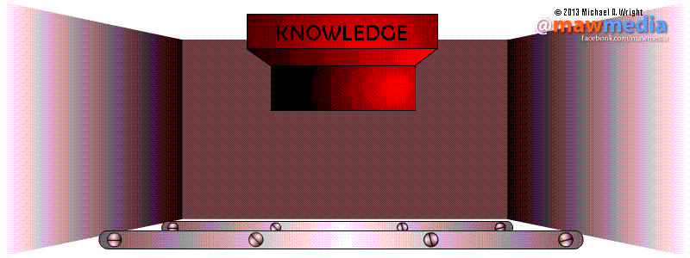
Current model of education

Slide 11
Sociocybernetic Control Model of Education (SCME)
Community as the Education System
Knowledge System
Intervention
Support
Inputs
Engagement
Feedback
Outputs
Assessment
Adjustment
Sharing
Data
Capture
Improvement
Student Outcome Data supports formative adjustments due to more system-embedded feedback.

Slide 12
The Point:
Strict behavioral modification will not yield the desired results.
The answer is a sustainability perspective, operational awareness, and use of ecological practice.

Slide 13
Question 2
Have you considered that families choose ignorance, are not educated in the PROCESS, and engage differently than schools communicate?

Slide 14
Reflection 2
Is there any value in shifting the “blame” to families?
We focus on family systems as the point of intervention and models.

Slide 15
The Framework IS SOCIAL
Vygotsky
  Social interaction is key to performance.
Bandura (2001) Self-Efficacy
  Self-Management
    Forethought
    Intentionality
Self-Awareness (Self-Reflectiveness)
Self-Correction (Self-Reactiveness)

Slide 16
Moving from Education to Choice
Perspective: From “Right” to “Sustainable”
Individual Assessment: Readiness & Barriers (CONTROLLABLES)

Slide 17
Barriers
Barriers: Your target system has built in resistance as a function of individual uniqueness and institutional needs.
Trauma
Attribution
Resilience

Slide 18
Trauma & Experience
Trauma is not just limited to catastrophic events or large scale tragedy. Trauma includes perceived losses, longing, or wishes unfulfilled. This definition does expand the population of those who can identify as having experienced trauma. The point of this definition is to validate the fact that perceived losses, longing, or wishes unfulfilled do impact choice behavior.
The measure of trauma/experience is the number of identifiable traumatic experiences, perceived losses, unfulfilled wishes and current or ongoing stressors related to culture.
<3 Mild 3-5 Moderate 6-9 Intense >9 Severe

Slide 19
Expectation & Attribution
Expectation/Attribution, as a paired construct, is the operationalization of social role influenced by locus of control. That is, expectation/attribution is the extent to which an individual perceives that outcomes are due to her consonant identity. Consonance, as the opposite of dissonance, refers to a state of congruence between beliefs about oneself and behaviors practiced by the individual.
As a reaction to trauma, sustainable expectation/attribution manifests in behaviors motivated by vulnerability, internal locus, and responsibility for outcomes.

Slide 20
Risk & Resilience
Risk/resilience, as a paired construct, is the extent to which an individual perceives that he will rebound if a risk turns out to be disappointing. In this paired definition, the focus is not resilience alone--only the ability to overcome trauma. Risk/Resilience is the ability of the individual to risk in the next choice encountered even though he has been disappointed.
The measure of risk/resilience is the amount of certainty the individual has of recovery no matter the outcome of the risk.

Slide 21
Question 3
What are the goals the family has represented in the student attending school?

Slide 22
Reflection 3
What behaviors are consistent with those goals?
Change behavior by influencing what messages are given from the system.

Slide 23
Moving from Person to Perception
Perspective: From “Chronological” to “Operational”
Institutional support of outcomes
Constructing an intervention (UNCONTROLLABLES)

Slide 24
Moving from Educational to Ecological
Perspective: From “Knowledge Delivery” to “Knowledge System”
Utility of ecological practice (economics--behavioral, technology, politics, sociology).
Holistic understanding of behavior change (EXECUTION)

Slide 25
Sociocybernetic Control Model of Education (SCME)
Community as the Education System
Knowledge System
Intervention
Support
Inputs
Engagement
Feedback
Outputs
Assessment
Adjustment
Sharing
Data
Capture
Improvement
Student Outcome Data supports formative adjustments due to more system-embedded feedback.

Slide 26
Recap
Sustainability Perspective, Operational Awareness, and Use Of Ecological Practice

Slide 27
Sustainability Perspective:
Recognize the unique challenge of individualizing education to each student.
The answer is found in standardizing choice architecture.
Provide students with the tools of Self-Efficacy, and switch the burden onto them.
From education to choice.

Slide 28
Operational Awareness:
Envision the educational system as a network including all community supports and culture.
Intervene by anticipating the challenges and creating supportive policies and procedures to address them.
Perceive the process as one of engagement, support, feedback, adjustment, repeat.
From chronological to operational.

Slide 29
Ecological Practice:
Utilize the tools that are available both physical and intellectual and philosophical.
Behavior is Motivation, Ability, and Trigger.
Motivation is Perception of Value and Expectation of Valued Reward.
Accountability is not shaming. It is doing as a trigger, to model and increase ability, to inspire motivation. Yet, the values are a result of relationships and culture.
From educational to ecological.

Slide 30
Final question
How does the culture of your classroom influence the community culture?

Slide 31
Reflection 2
Is there any value in shifting the “blame” to families?
We focus on family systems as the point of intervention and models.

