Slide 1
CCSS + SEL =
Educating the Whole Child

Slide 2
College and Career State Standards
As states begin to implement the Common Core State Standards and associated assessments, there is an opportunity to leverage social and emotional learning to facilitate the higher -order instruction and engagement required by college and career readiness standards. With an emphasis on self-control, goal setting and collaboration, social and emotional learning can develop the capacity of students for this work such as active speaking and listening, working effectively in teams and being persistent with challenging subject matter.
~CASEL

Slide 3

All in a Day’s Work

Slide 4

Balanced Literacy
120 – 150 minutes daily
  Whole Group
  Guided Reading
  Shared Reading
  Read alouds
  Phonics
  Phonemic Awareness
  Word Study
  Vocabulary
  Fluency

Slide 5

Writer’s Workshop
45 minutes daily
  Mini Lesson
  Independent writing/conferencing
  Share time

Slide 6

Balanced Math
60 minutes daily
  Problem of the Day
  Mental math
  Math review
  Concept lesson/math centers
  Closure

Slide 7
Not to Mention…
  Focus Calendar /Intervention
  Attendance
  Bathroom breaks
  Fire Drills
  Recess
  Lunch
  Related Arts
  Discipline Problems
  Sick children
  Collecting money for field trips and fundraisers

Slide 8

AND…
    Assessments!
          Assessments!
                Assessments!

Slide 9

How Can We Fit Another Thing On Our Plates?
Social studies
Reading
Science
Writing
Math
Notes:
Our plates are already so full, but by implementing Social and Emotional Learning, we can reap benefits far into the future.

Slide 10
Social and Academic Learning Go Hand in Hand
Academic learning happens best within a positive social context.
Optimal learning happens when teachers pay lots of attention to teaching children positive social skills in the context of daily routines.
Children benefit when teachers pay attention to how children treat each other.
All human beings have basic social and emotional needs that must be met if we are to be free to learn well and thrive. We need to feel as since of belonging, significance and fun with engagement.
Great cognitive growth occurs through social interaction.
Notes:
This is not one more thing!

Slide 11
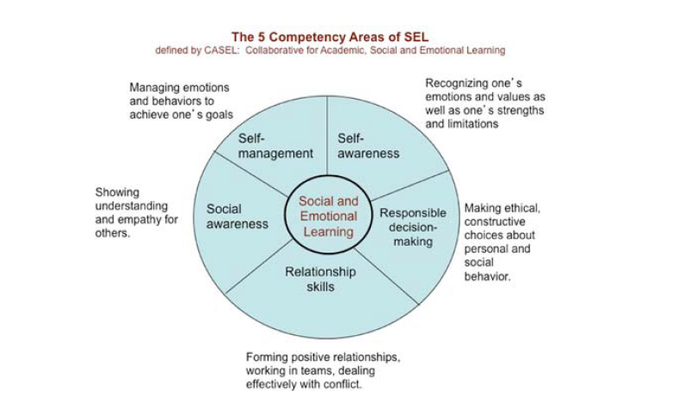
Notes:
Social and Emotional Learning is made of the following 5 competencies: (read the slide).

Slide 12

Responsive Classroom
Notes:
One way to foster Social and Emotional Learning is to use a program such as Responsive Classroom.
Teachers create engaging activities that are interactive, have purpose and include choice.
Teachers need to create a positive community, where students are emotionally safe and willing to take risks.
Teachers need to have effective management , with a structure environment where students can focus on learning.

Slide 13
Classroom Practices
Classroom Organization
Positive Teacher Language
Interactive Modeling
Rule Creation
Logical Consequences
Hopes and Dreams
Notes:
Classrooms need to be arranged that promotes cooperation and productivity..seating, meeting place
Language need to promote learning and discipline while using words and tones they understand…I notice, I see
Model every expected behavior from behaviors, to routines to academics.
Students should help create the classroom rules so they are able to meeting their learning goals and have buy in
Students are more likely to follow rules if they create the consequences, and if we respond in a respectful way..
Hopes and dreams allow us more insight to children and help them create learning goals

Slide 14
Practices Continued
Morning Meeting
Academic Choice
Guided Discovery
Collaborative Problem Solving
Working with Families
Notes:
Students get to greet, share news, participate in an activity, and complete a message…great way to foreshadow the day and integrate standards
When we allow students choice children are impowered and take charge of learning…manipulatives, centers, worksheets
Allow students to discover meaning gives them creativity and responsibility for learning…we often front load and spoon feed them too much
When students collaboratively problem solve they learn to communicate and resolve their issues
When we Include families we learn more about the child and teach them the school’s teaching approach, which will hopefully carry on in their homes

Slide 15
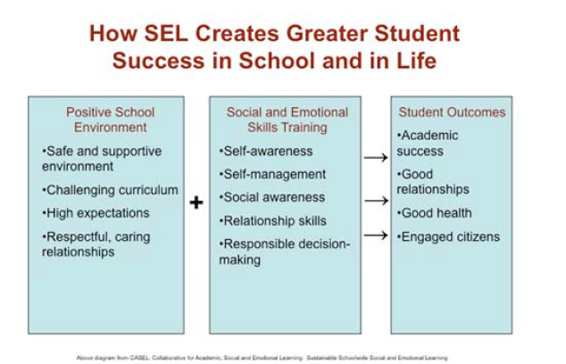
Notes:
Read the slide.

Slide 16

Social and Emotional Learning also…
Less discipline problems
More time on task
Effective teachers
Better staff moral

Slide 17
How Can We Afford NOT to Add One More Serving to our Plates?
Social and Emotional Learning
Writing
Social Studies
Science
Reading
Math

Slide 18
One Final Thought…
We cannot neglect social and emotional development. If we do, you can forget about academics.
~Dr. Jesse Register

