Slide 1
January 14th, 2013
Dear Fabulous Fourth Graders,
We’ve been talking about audience and purpose. Who does this advertisement appeal to and why? Please use the sentence starter below.
This advertisement appeals to ______________________ because ___________.
It’s purpose is to _____________________.
Sincerely,
Ms. F

Slide 2
Property Practice
Choose the correct property and color to gain yourself tally marks!
Which of the following shows the commutative property of multiplication?
A.4 × 3 = 12 × 1
B.4 × 3 = 3 × 4
C.4 × 1 = 4
D.4 × 0 = 0

Slide 3
Property Practice
Choose the correct property and color to gain yourself tally marks!
7 × 5 × 2
The properties of multiplication make multiplying easier. Which of the following is the associative property of multiplication?
A.(3 × 5) + (4 × 5) + × 2
B.7 × (5 × 2)
C.5 × 7 × 2
D.(5 × 2) + (5 × 7)

Slide 4
January 15th, 2013
Dear Fabulous Fourth Graders,
We’ve been talking about audience and purpose. Who does this advertisement appeal to and why? Please use the sentence starter below.
This advertisement appeals to ______________________ because ___________.
It’s purpose is to _____________________.
Sincerely,
Ms. F

Slide 5
Property Practice
Choose the correct property and color to gain yourself tally marks!
7 × 5 × 2
The properties of multiplication make multiplying easier. Which of the following is the associative property of multiplication?
A.(3 × 5) + (4 × 5) + × 2
B.7 × (5 × 2)
C.5 × 7 × 2
D.(5 × 2) + (5 × 7)

Slide 6
Property Practice
Choose the correct property and color to gain yourself tally marks!
7 × 5 × 2
The properties of multiplication make multiplying easier. Which of the following is the associative property of multiplication?
A.(3 × 5) + (4 × 5) + × 2
B.7 × (5 × 2)
C.5 × 7 × 2
D.(5 × 2) + (5 × 7)

Slide 7
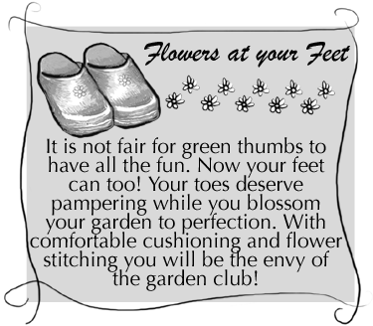
January 16th, 2013
Dear Fabulous Fourth Graders,
We’ve been talking about audience and purpose. Who does this advertisement appeal to and why? Please use the sentence starter below.
This advertisement appeals to ______________________ because ___________.
It’s purpose is to _____________________.
Sincerely,
Ms. F

Slide 8
Property Practice
Choose the correct property and color to gain yourself tally marks!
Compare.3 × 7 × 4 ____ 4 × 3 × 7
A.<
B.>
C.=
D.≠

Slide 9
Property Practice
Choose the correct property and color to gain yourself tally marks!
Choose the answer that uses the distributive property to simplify 6 × 42.
A.(6 × 40) + (6 × 2)
B.42 × 6
C.(6 × 40) × (6 × 2)
D.(6 × 1) × (42 × 1)

Slide 10
January 17th, 2013
Dear Fabulous Fourth Graders,
We’ve been talking about audience and purpose. Who does this recipe appeal to and why? Please use the sentence starter below.
This recipe appeals to ______________________ because ___________.
It’s purpose is to _____________________.
Sincerely,
Ms. F

Slide 11
Property Practice
Choose the correct property and color to gain yourself tally marks!
Solve the problem.4(10+5)=
A.20
B.60
C.45
D.19

Slide 12
Property Practice
Choose the correct property and color to gain yourself tally marks!
What number property would be the most helpful to find the product of 20 × 1?
A.identity property
B.zero property
C.commutative property
D.associative property

Slide 13
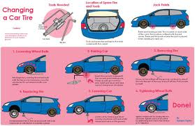
January 18th, 2013
Dear Fabulous Fourth Graders,
We’ve been talking about audience and purpose. Who does this image appeal to and why? Please use the sentence starter below.
This image appeals to ______________________ because ___________.
It’s purpose is to _____________________.
Sincerely,
Ms. F

Slide 14
Property Practice
Choose the correct property and color to gain yourself tally marks!
This problem is an example of what property?6 × 18 = (6 × 10) + (6 × 8)
A.Associative Property
B.Communicative Property
C.Inverse Operation
D.Distributive Property

Slide 15
Property Practice
Choose the correct property and color to gain yourself tally marks!
Which one of these is an example of the Distributive Property?
A.9 × 15 = 135
B.9 × 15 = (9 × 10) + (9 × 5)
C.9 × 15 = 15 × 9
D.9 × 15 = 3 × 56

