Slide 1
How Do You Get To Your Dreams FROM Here? Making It Real For Your Students

Slide 3
The quality of our life is determined by the quality of dreams we make come true.

Slide 4
Do You Encourage Your Students To Dream?
Notes:
A license for success --

Slide 5
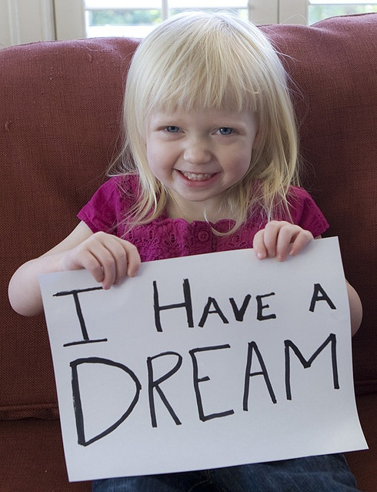
What Were Your Dreams?
Do You Remember?

Slide 6
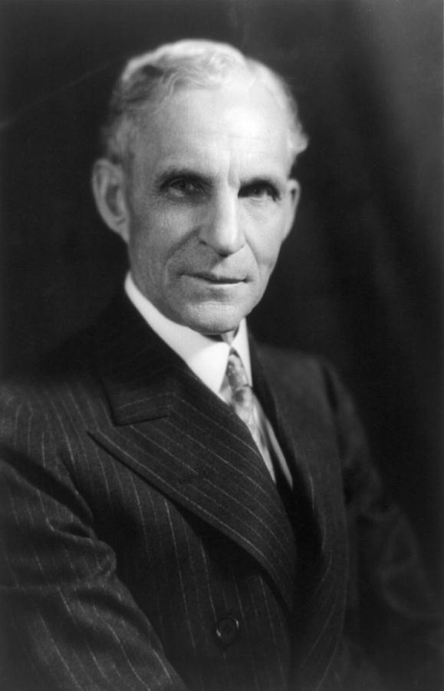
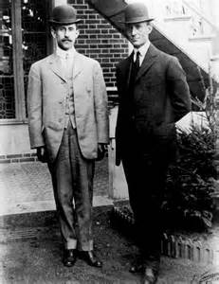
DREAMERS

Slide 7
What Do You Want To Be When You Grow Up?

Slide 8
HOW DO I ENCOURGE MY STUDENTS TO DREAM
AND
KEEP IT REAL?
Rigor
Relevance
Relationships

Slide 9
The A B C’s of Dreaming
A
Awareness
Attitude/Ambition
Achievement
Action

Slide 10
The A B C’s of Dreaming
B
Behaviors:
You’re Great – No Matter What
Persistence Pays Off
Welcome the Unknown
Farewell to Worry
Peace Begins with You
Enjoy the Here and Now
Healthy Me
Creativity is the Key
What Can You Give?

Slide 11
The A B C’s of Dreaming
C
Confidence
Communication
Change
Choice

Slide 12
The problem is never in the _______. The problem is always in the ________ about the problem.
problem
thinking

Slide 13
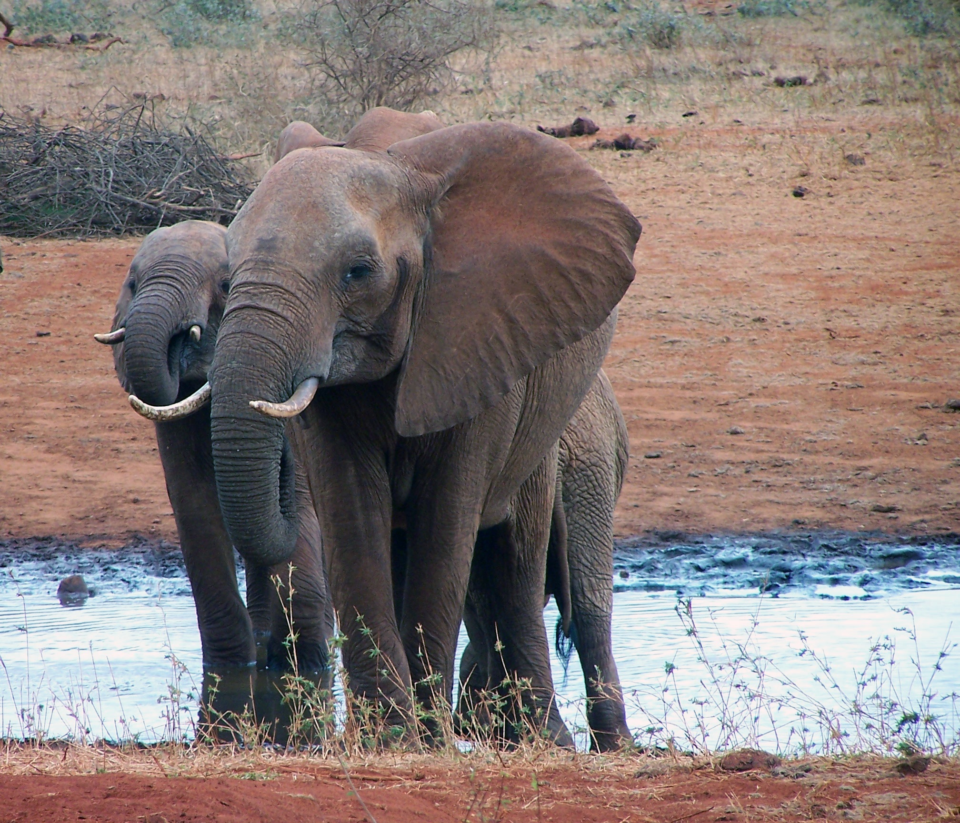
River Reed Thinking

Slide 14
Are Your Ready to Take the Leap?

Slide 15
Defining & Designing Your Dream

Slide 16
What would I LOVE?

Slide 17
Pay attention to your _______ and to your _________.
longings
discontent

Slide 18
Testing Your Dream
What would you love?

Slide 19
Putting On Your Dream
Job/Career Time/Money
Relationships Health/Wellness

Slide 20
We cannot get to our dream
We must come from it, and
In order to come from it
We must become it.
~ Mary Manin Morrissey~

Slide 21
What would I do if I didn’t believe it was impossible?

Slide 22
Denise Yeargin, M.Ed. Life Coach/Speaker/Spiritual Counselor www.highvibrationzone.com RevDenise@Comcast.net 615/879-5122

