Slide 1
Social & Human Agency for Kids
June 19, 2015
Scottish Washington & Michael Wright,
Tennessee State University
An emerging model integrating art & play in education

Slide 2
Presenters
Scottish Washington
Scottish.Washington@gmail.com
BSW Candidate, TSU
Michael Wright
eduanimator@gmail.com
Associate Professor, TSU

Slide 3
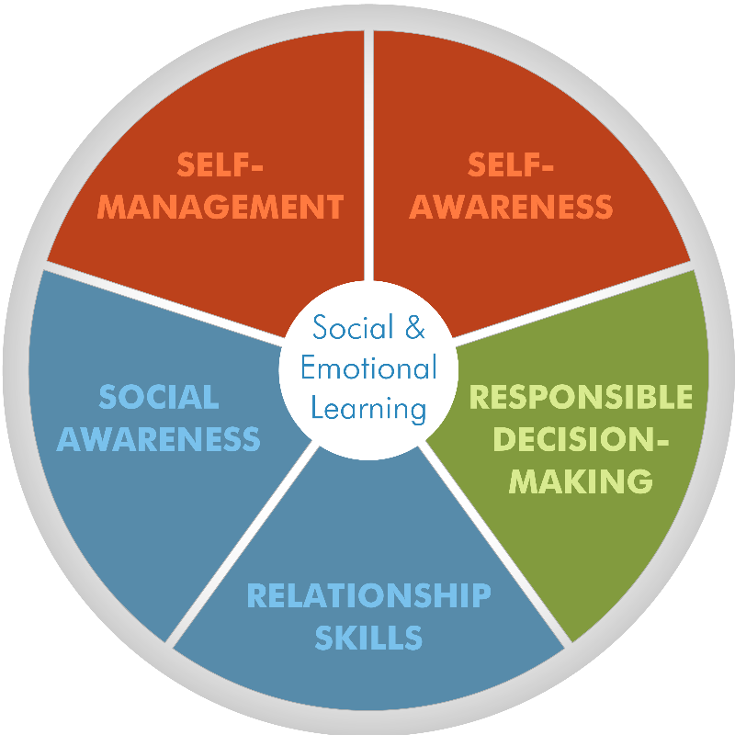
Overview
Problem
Project description
Social agency is the goal for SEL competencies.
A “Social Agency Model of Education” with student assessment and implementation hierarchy.
Project methodology
Express Bandura’s model of social agency in the context of Play and Art across primary and secondary education.
Key Results
Assessment Continuum
Implementation Model
Conclusion
Integrate!

Slide 4
Problem: The Typical Classroom

Slide 5
Project Description 01: Bandura’s Model
:Intentionality (Planner) self-motivation to affect some outcome through personal actions.
:Forethought (Forethinker) anticipation of future consequences and ordering of actions to achieve a desired outcome and avoid detrimental outcomes.
:Self-Reflectiveness a metacognitive exercise in which one judges the correctness of predictive and operative thinking against actual outcomes; contributes to assessment of self-efficacy.
:Self-Reactiveness is the ability to shape appropriate course of action, motivate and regulate execution through sub-functions of self-monitoring, self-guidance by personal standards, and self-correction (corrective self-reaction).

Slide 6
Project Description 02: Art & Play
Art
Play
Requiring materials or roles combined in a specific way.
Requiring physical activity organized around some goal or situation.

Slide 7
Project Methodology 01: Intentionality
Opportunity
Required for Use as Solution
Intentionality: Children are not confined to prior plans. Their view and creativity has no limitations, therefore children are not fully aware of consequences.
Goal orientation and outcome focus.
As Opposed to: process stricture and micro-management.

Slide 8
Project Methodology 02: Forethought
Opportunity
Required for Use as Solution
Forethought: Children have no sense of the future, except anticipation within a particular moment. Children live moments. They live in moments, feel in moments, and learn in moments.
Expression of role and creativity in the moment.
As Opposed to: blanket “you should know better,” (be a robot) and focus on instructions that are “I want it done like this…”.

Slide 9
Project Methodology 03: Self-Reflectiveness
Opportunity
Required for Use as Solution
Self-Reflectiveness: Children learn through healthy competition. They build their creativity through copy and complement. They express self-knowledge through complimenting others and improving their own product. They also learn how to recognize themselves in their work.
Expression of details, steps, reasoning for choices, and why.
As Opposed to: rote responses without additional individual and group exploration.

Slide 10
Project Methodology 04: Self-Reactiveness
Opportunity
Required for Use as Solution
Self-Reactiveness: Children will listen to what is being said, test it, get a result, and determine if it was a result that satisfied them at all. Due to children living in the moment and desire for more immediate gratification, results that do not provide instant gratification is obsolete.
Ability to update, change, and respond to critique.
As Opposed to: one submission and done approaches to education.

Slide 11
Key Results 01: Assessment Continuum
Art
Play
Intentionality
Ability to express complexity (interactions) in production goal.
Low Level: Simple
High Level: Complex
Intentionality
Ability to express complexity (interactions) in pursuit of the goal.
Low Level: Simple
High Level: Complex

Slide 12
Key Results 02: Assessment Continuum
Art
Play
Forethought
Ability to express complexity (interactions) of the details of the project as creativity.
Low Level: Simple
High Level: Complex
Forethought
Ability to express complexity (interactions) in expression of the role.
Low Level: Simple
High Level: Complex

Slide 13
Key Results 03: Assessment Continuum
Art
Play
Self-Reflectiveness
Ability to identify and describe personal touches and reasoning added to project.
Low Level: Simple
High Level: Complex
Self-Reflectiveness
Ability to list the steps of an approach in detail including interactions expected.
Low Level: Simple
High Level: Complex

Slide 14
Key Results 04: Assessment Continuum
Art
Play
Self-Reactiveness
Ability to respond to critique with reasoned changes.
Low Level: Simple
High Level: Complex
Self-Reactiveness
Ability to express changes and reasoning for changes based on situations.
Low Level: Simple
High Level: Complex

Slide 15
Key Results 05: Implementation Structure
Full Group Presentation
Small Group Regulation
Individual Self-Regulation
Small group to large group or circles of responsibility: Kids work with their small groups to prepare for presentations to the larger group.

Slide 16
Conclusion: Integrate!
Stop punishing by removing recess.
Stop micro-managing classroom.
Stop implementing “Sit-down and Shut-Up” as life skills.
Crafting in Basic Knowledge
Reading round robin/Diorama
Math through Music
Video Diaries/Storytelling through music/video
Role play: give students clear roles
Live board games
Career Plays: the office, research center, school, engineering agency, architect house

Slide 17
Questions & Discussion

