Slide 1
Social Emotional Learning through an ABA Lens
Annette Little, PhD, BCBA-D
Lipscomb University

Slide 2
Social Emotional Learning (SEL) program designers are interested in promoting the integration of emotion, cognition, communication, and behavior when creating programs to improve social and emotional skills of children (Crick & Dodge, 1994; Lemerise & Arsenio, 2000). The purpose of this presentation is to focus on the behavior piece of this pie. The presenter will explain how Applied Behavior Analysis (ABA) can enhance any SEL program to provide better outcomes.

Slide 3
Goals of SEL programs (Collaborative for Academic, Social, and Emotional Learning, 2005)
self-awareness
self-management
social awareness
relationship skills
responsible decision making
ABA Perspective
How do you operationalize and measure these?

Slide 4
Student Outcomes (Durlak, et al., 2011)
Social and emotional skills
Attitudes toward self and others
Positive social behaviors
Conduct problems
Emotional distress
Academic performance

Slide 5
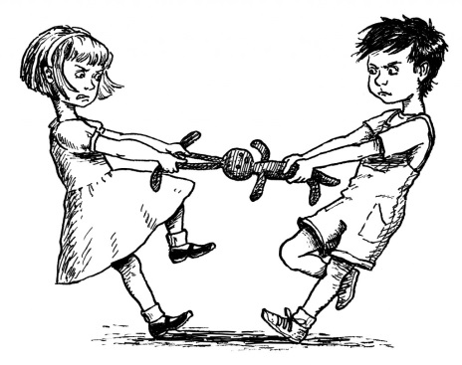
Social Emotional Skills (Durlak, et al., 2011)
Identifying emotions from social cues
Goal setting
Perspective taking
Interpersonal problem solving
Conflict resolution
Decision making
Interviews, role plays, or questionnaires

Slide 6
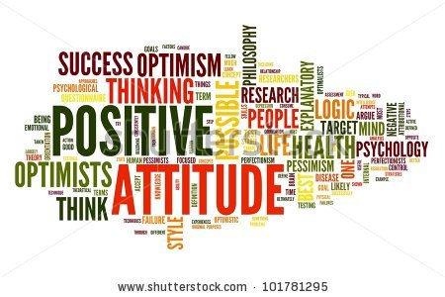
Attitudes Toward Self and Others (Durlak, et al., 2011)
Self-perceptions (e.g.,self-esteem, self-concept, and self-efficacy)
School bonding (e.g., attitudes toward school and teachers)
Conventional (i.e., prosocial) beliefs about violence, helping others, social justice, and drug use
Student self-reports

Slide 7
Positive Social Behavior (Durlak, et al., 2011)
What does this
look like?
Getting along with others
Derived from the student, teacher, parent, or an independent observer
Elliott and Gresham’s Social Skills Rating Scale (Elliott, Gresham, Freeman, & McCloskey, 1988)

Slide 8
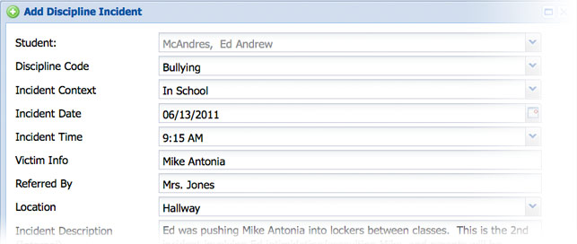
Conduct Problems (Durlak, et al., 2011)
Disruptive class behavior
Noncompliance
Aggression
Bullying
School suspensions
Delinquent acts
Child Behavior Checklist (Achenbach, 1991), student self-reports, teacher or parent ratings, or independent observers, or school records

Slide 9
Emotional Distress (Durlak, et al., 2011)
Depression
Anxiety
Stress
Social withdrawal
Reports by students, teachers, or parents on measures such as the Children’s Manifest Anxiety Scale (Kitano, 1960).

Slide 10
Academic Performance (Durlak, et al., 2011)
Standardized reading or math achievement test scores from such measures as the Stanford Achievement Test or the Iowa Test of Basic Skills
School grades in the form of students’ overall GPA or their grades in specific subjects

Slide 11
What’s next?
From operationally defined behaviors to intervention implementation

Slide 12
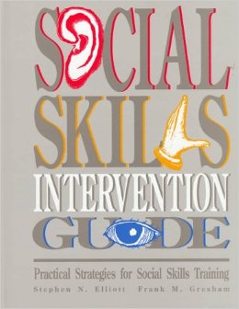
S.A.F.E. (Collaborative for Academic, Social, and Emotional Learning, 2005)
Does the program use a connected and coordinated set of activities to achieve their objectives relative to skill development? (Sequenced);
Does the program use active forms of learning to help youth learn new skills? (Active);
Does the program have at least one component devoted to developing personal or social skills? (Focused);
Does the program target specific SEL skills rather than targeting skills or positive development in general terms? (Explicit).

Slide 13
Effective S.E.L. Programs (Durlak, et al., 2011)
Programs following all four recommended training procedures (SAFE) produced significant effects for all six outcomes, whereas programs not coded as SAFE achieved significant effects in only three areas (i.e., attitudes, conduct problems, and academic performance).
Programs that encountered implementation problems achieved significant effects in only two outcome categories (i.e., attitudes and conduct problems), interventions without any apparent implementation problems yielded significant mean effects in all six categories.
Is your
Program S.A.F.E.?
Is your program being
implemented
as intended?
Do you have
implementation
support?

Slide 14
Casel Guide

Slide 16
Guiding Questions
Can I measure my target behaviors?
Does my intervention meet S.A.F.E. standards?
Do I have enough support available for proper implementation?
How will I know if the intervention package is being implemented as intended?
How will I know if the intervention package is working?
How often do I look at my data?
What criteria constitutes needing additional support?
What will Tier 2 & 3 supports look like?

Slide 17
Resource
http://static1.squarespace.com/static/513f79f9e4b05ce7b70e9673/t/526a220de4b00a92c90436ba/1382687245993/2013-casel-guide.pdf

Slide 18
PBIS Survey Activity

Slide 19
References
Collaborative for Academic, Social, and Emotional Learning. (2005). Safe and sound: An educational leader’s guide to evidence-based social and emotional learning programs— Illinois edition. Chicago: Author.
Crick, N. R., & Dodge, K. A. (1994). A review and reformulation of social information-processing mechanisms in children’s social adjustment. Psychological Bulletin, 115, 74–101.
Durlak, J. A., Weissberg, R. P., Dymnicki, A. B., Taylor, R. D., & Schellinger, K. B. (2011). The impact of enhancing students’ social and emotional learning: A meta‐analysis of school‐based universal interventions. Child development,82(1), 405-432.
Lemerise, E. A., & Arsenio, W. F. (2000). An integrated model of emotion processes and cognition in social information processing. Child Development, 71, 107–118.

