Slide 1
Socio-Emotional Development of Young Adolescents: Fact and Fiction
Bobette Bouton, Ph.D.

Slide 2
Bobette Bouton
boutonb@apsu.edu
Assistant Professor at Austin Peay State University, Clarksville, TN
Primary research: Empathy within pre-service teachers

Slide 3
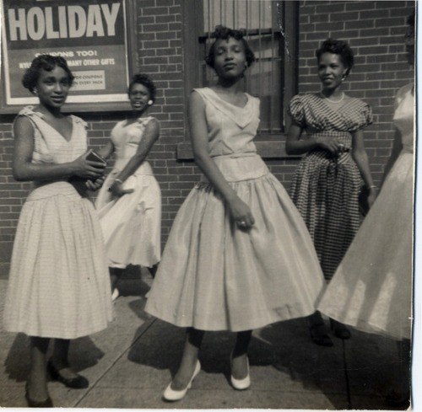
Presentation Explanation
Literature Review
Comparing three major studies that defined adolescents throughout history to recent research both confirming and contradicting ideas about the socio-emotional development of young adolescents.

Slide 4
Purpose
To tease apart the information that we have held as truth for many years based on early information from that which is fiction based using more recent research.

Slide 5
Individual Task
Using the sticky notes provided please write down as many traits or attributes that you can think of that describe adolescence/adolescents. (2 minutes)

Slide 6
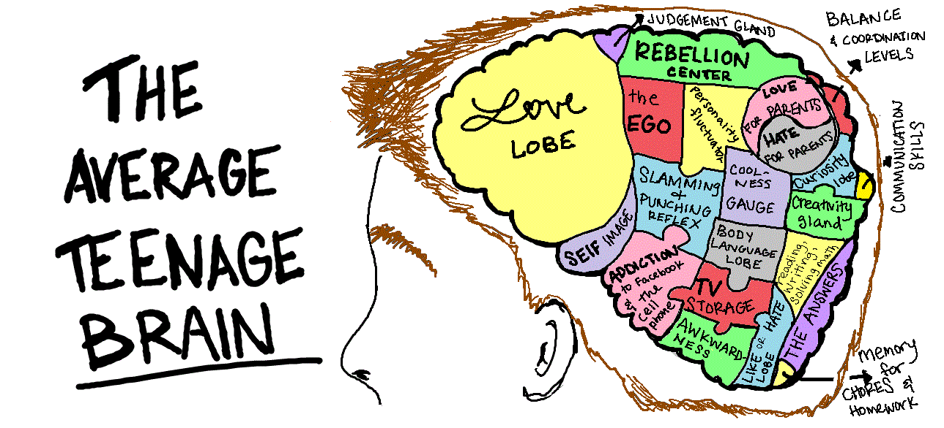

Slide 7
Plan for the Next Hour
Discuss the historic texts from which adolescence was first defined.
Discuss the newer research found.
Small group work to brainstorm how we can begin to view adolescence and socio-emotional learning more productively and positively.

Slide 8
Adolescence Defined
Hall (1904) defined it from ages eight to twelve;
Tanner (1962), who emphasized puberty more, had a larger age differentiation of age six to fifteen;
Many other authors fall somewhere in between these ages only loosely defining adolescence as the time period between childhood and adulthood (McRae, et al.,2012; Lerner & Galambos, 1998; Eccles, et al., 1993; Lexmond, 2003);
My definition for this Literature Review: the onset of puberty to define the beginning of young adolescence and continuing on until the start of adulthood or the completion of the physiology maturation effects of puberty.

Slide 9
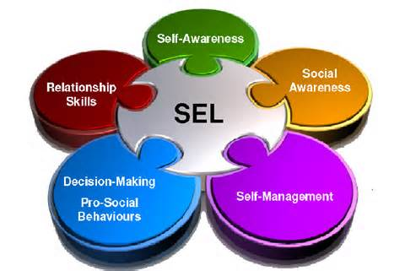
Socio-Emotional Development Defined
“Emotions that require the representation of mental states” (Burnett et al., 2008).
Adolescence is a peak time when both social and emotional development are extremely active both due to brain maturation and hormone level changes that occur during puberty (Burnett et al., 2008; Yurgelun-Todd, 2007).

Slide 10
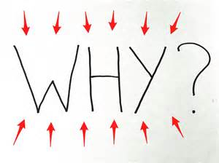
Why Try to Connect Adolescence to Socio-Emotional Development?
Academics, personality, nor any of the other single descriptors used to describe young adolescents can solely be focused on alone, but instead “an accurate conceptualization of cognitive and neurobiological changes during adolescence must treat adolescence as a transitional developmental period, rather than a single snapshot in time” (Casey, Getz, & Galvan, 2008).

Slide 11
3 Questions Asked
What are the historical beliefs concerning young adolescents physiological and socio-emotional development?
What is the empirical response to the historical perspective of the connection between physiological and socio-emotional development of young adolescents?
What are the implications for future research based on the findings of young adolescent socio-emotional development?

Slide 12
What are the historical beliefs concerning young adolescents physiological and socio-emotional development?

Slide 13
G. Stanley Hall
G.Stanley Hall (1904) was the first to begin to explore adolescent development and write about the extreme and multi-faceted growth that takes place during this stage.
Hall (1904) was also the first to describe adolescence as a time of “storm and stress” due to both physiological and psychological development.

Slide 14
What are the historical beliefs concerning young adolescents physiological and socio-emotional development?
“The years from about eight to twelve constitute a unique period of human life. The acute stage of teething is passing, the brain has acquired nearly its adult size and weight, health is almost at its best, activity is greater and or varied than ever before or than it ever will be again, and there is peculiar endurance, vitality, and resistance to fatigue. The child develops a life of its own outside the home circle, and its natural interests are never so independent of adult influence. Perception is very acute, and there is great immunity to exposure, danger, accident, as well as to temptation. Reason, true morality, religion, sympathy, love, and esthetic enjoyment are but very slightly developed” (Hall, 1904, p. ix)

Slide 15
What are the historical beliefs concerning young adolescents physiological and socio-emotional development?
Hall (1904) gives details concerning puberty and lists ten common traits of puberty that involve both physical and socio-emotional development:
(1) “inner absorption and reverie”;
(2) “birthday of the imagination”;
(3) dark “self-criticism and consciousness”;
(4) “overassertion of individuality”;
(5) increased imitation;
(6) increased dramatization of multiple aspects;
(7) “age of folly”;
(8) “new attitude toward speech”;
(9) inconsistent socialization;
(10) extreme fluctuation of action and mood (p. 311).

Slide 16
J.M. Tanner
J. M. Tanner’s (1962) Growth at Adolescence. Tanner almost primarily looked at physical growth and development with only a sparse discussion concerning more psychological and behavioral development.
What Tanner (1962) did for learning about adolescence is divide up puberty into five stages of development focusing on pubic hair and breast development for girls and pubic hair and penis development for boys.

Slide 17
What are the historical beliefs concerning young adolescents physiological and socio-emotional development?
Tanner (1962) began to address the vast differences that occur physically during adolescence this helped establish a clearer link between puberty and socio-emotional development especially concerning gender differences.
Tanner (1962) refers to Hall’s “storm and stress” phrase but uses “Sturm and Drang” but does acknowledge that “the most important task is to decide how much of adolescent behaviour is due to biological, and how much to cultural factors” (p. 217).

Slide 18
Simmons and Blyth
Simmons and Blyth’s (1987), Moving into Adolescence: The impact of pubertal change and school context. In the 25 years between these books less detail is given to actual physical development and more to the transitional aspect from childhood to adolescence.
Simmons and Blyth (1987) also looked more thoroughly through the lens of psychosocial development using two large scale studies that primarily focused on self-image and the gender differences.

Slide 19
What is the empirical response to the historical perspective of the connection between physiological and socio-emotional development of young adolescents?

Slide 20
Facts Found

Slide 21
Brain Connections
The review of the literature found thirteen out of the twenty-five studies used that focused on brain development in young adolescents; ten of which focused on the frontal lobe.
The frontal lobe is the region of the brain that controls behavior, emotion, perception, risk, and reward which can directly impact how young adolescents interact with the environment around them (Steinberg, 2005).

Slide 22
Brain Connections
Emotional reactivity, or “the tendency to experience frequent and intense emotional arousal. Both the threshold and ease with which individuals become emotionally aroused and the intensity of emotion” (Spinrad et all, 2004), that is shown to occur in the brain can have direct impact on social behavior (Nelson et al., 2005; Casey et al., 2010).
These findings have incredible promise to furthering the understanding to how brain development during the onset of puberty impacts the socio-emotional development that is also occurring at this time.

Slide 23
Brain Connections
If interested, the below Ted Talk is a great source of information regarding the brain development in adolescence.
Sarah-Jayne Blakemore: The Mysterious Workings of the Adolescent Brain
https://www.youtube.com/watch?v=6zVS8HIPUng

Slide 24
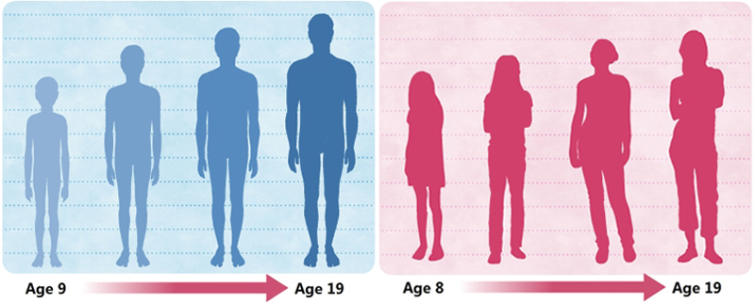
Puberty Connections
The “interpersonal, physical and hormonal changes associated with puberty may contribute to changes in the behavioural and neural correlates of social emotional processing” (Burnett, 2010, p. 682).
“Hormonal changes that occur during adolescence are likely to account for at least part of the risk for mood and anxiety disorders” (Paus, Keshavan, & Giedd, 2008).

Slide 25
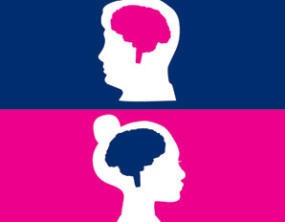
Gender Connections
The similarities and differences in gender were considered in all three historical texts, but only mentioned in three of the more current studies reviewed.

Slide 26
Gender Connections
Garaigordoil (2009) also used gender differences to look at socio-emotional variables and found that girls did in fact have significantly higher scores in pro-social behavior, emotional understanding, and anxiety-shyness, and that boys and girls had similar scores in self-concept and anti-social behaviors.

Slide 27
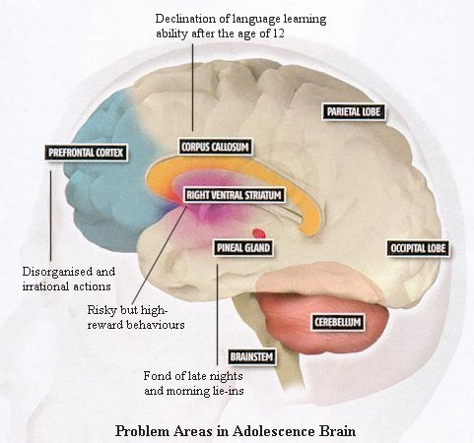
Changes in Socio-Emotional Behavior
Risk and Impulse Behaviors
Peer and Social Influence

Slide 28
Risk and Impulse Behaviors
Pfeifer et al (2011) found “greater subcortical reactivity to affective facial displays” in young adolescents which can impact impulse control but not in all youth (p. 1034). And Casey, Getz, & Galvan (2008) found similar findings with impulsivity being “associated with immature ventral prefrontal development” (p. 72).

Slide 29
Risk and Impulse Behaviors
Three other studies found the risk taking behaviors in young adolescence related to peer and social influences, as well as, brain development (Steinburg, 2005; Pfeifer et al., 2009; Lerner and Galambos, 1998).

Slide 30
Risk and Impulse Behaviors
According to a 1990 survey, about 50% of the “28 million youth between the ages of 10-17” engage in two or more of the following risk behaviors: “(a) drug and alcohol use and abuse; (b) unsafe sex, teenage pregnancy, and teenage parenting; (c) school underachievement, school failure, and drop out; and (d) delinquency, crime, and violence” (Lerner & Galambos, 1998).

Slide 31
Peer and Social Influences on Behavior
The further development of the fronto-parietal network impacts self-perception processing and can influence adolescents views of how others perceive them (Pfeifer et al., 2009).
Eccles et al. (1993) conducted an earlier study on stage-environment fit on young adolescents and looked at the importance of social environments on meeting psychological needs. They reported that both teacher, peer, and self all contribute to socio-emotional development in the school system and that “optimal development takes place when there is good stage-environment fit between the needs of developing individuals and the opportunities afforded by their social environments” (Eccles et al., 1993, p. 95).

Slide 32
Peer and Social Influences on Behavior
Although not as much is known concerning young adolescent internalizing problems versus externalizing, it is noted repeatedly that adolescents are beginning to read the cues of others by learning how to respond in more interpersonal relationships, and this regard for other’s opinions can impact socio-emotional development in both positive and negative ways (Steinbert & Morris, 2001; Yurgelun-Todd, 2007; Burnett et al., 2010).

Slide 33
Peer and Social Influences on Behavior
Through brain imaging it can be seen that “adolescence clearly represents a period of heightened emotional responsiveness to social stimuli and socially related events” and that these changes need the new found ability for constant reappraisal of situations both innocuous and potentially threatening (Nelson et al., 2005, p. 169).

Slide 34
Fiction Found

Slide 35
Physiological/Socio-Emotional Connection Fiction
Blakemore’s (2008) brain study found no empirical evidence that “reported significant behavioral development that is specific to social cognition and that cannot be explained by general improvements in attention, concentration, memory, and so on” (p. 275).
Garaigordobil (2009) found no statistical evidence in regards to gender that boys exhibit more anti-social behavior during young adolescents than girls.

Slide 36
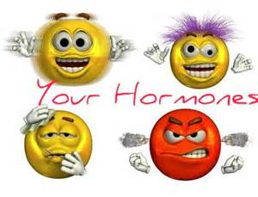
Physiological/Socio-Emotional Connection Fiction
While there is some evidence that these hormones can bring about moodiness, as mentioned in the fact section, it only accounts for a small percentage than what is popularly believed. Instead social situations have been found to be more responsible for moody behavior than actual hormone levels (Steinberg & Morris, 2001; Lerner & Galambos, 1998; Buchanan, Eccles, & Becker, 1992).

Slide 37
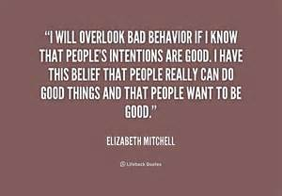
Physiological/Socio-Emotional Connection Fiction
Because of the many variables that can impact adolescent development (i.e. genetic, family and peer influences, etc.) it is often difficult to pull apart one area of socialization and deem it the cause for certain behaviors (Steinberg & Morris, 2001).

Slide 38
Physiological/Socio-Emotional Connection Fiction
Tanner’s (1962) stages of development, although used as a standard of pubertal measurement for many years, have been found by many researchers to not be as generalizable as once thought; it must be recognized that more variation occurs in young adolescents during puberty than what Tanner summarized (Burnette et al., 2010; Blakemore, Burnett, & Dahl, 2010; Lerner & Galambos, 1998).

Slide 39
Physiological/Socio-Emotional Connection Fiction
Overall, young adolescence, both physiological and socio-emotional development, is incredibly complicated and cannot be matter-of-factly measured to generalize all males and females going through puberty.

Slide 40
Until the popular belief that hormones alone are the cause of emotional upheaval during young adolescents masses of young adolescents everywhere will continue to have this negative stereotype attached to them and the real reasons for the emotional instability that sometimes occurs during this developmental stage will not be identified and addressed more satisfactorily.

Slide 41
What are the implications for future research based on the findings of young adolescent socio-emotional development?

Slide 42
Limitations
The primary limitation of this literature review is the lack of current empirical research in the field of socio-emotional development in young adolescents, especially as it pertains to neurological research and puberty.
The current researchers who are trying to find answers to the “developmental patterns in the affective and attitudinal characteristics often associated with the adolescent period (e.g. moodiness, shifts in energy, irritability, restlessness) or linked patterns to the hormonal changes of puberty” (Buchanan, Eccles, & Becker, 1992) agree that much more work needs to be done in this field (Burnett et al., 2008; Blakemore, Burnett, & Dahl, 2010; Blakemore, 2008; Steinberg, 2005).

Slide 43
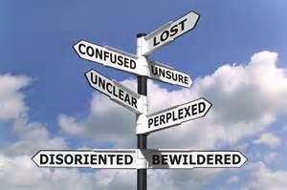
Future Direction
Brooks-Gunn, Rock & Warren (1989) simply stated several years back “The study of adolescence is important because the way young people cope with the changes occurring at this stage of life lays the groundwork for the emergence and maintenance of behaviors related to physical and mental health” (p. 51).

Slide 44
Future Direction
What does it mean for SCHOOLS???
Often times negative stigma attached to young adolescents, “teachers’ grade level preferences and ideas about appropriate pedagogy, curriculum, and discipline for middle level students” can determine how students are taught without full facts available to teachers (Lexmond, 2003).
Until additional research is conducted the proper “stage-environment fit” will be difficult for teachers to construct in their classrooms resulting in difficult learning environments (Eccles et al., 1993). In addition to teacher-student interaction, one study found that more positive peer relationships led to less disruptiveness and safety issues in the school, as well as higher student self-esteem and lower instances of substance abuse related behaviors (Brand et al., 2008).

Slide 45
Future Direction
Without the socio-emotional development knowledge of young adolescents and what can impact both positive and negative changes at this stage in life, parents, teachers, and youth are trapped in fiction and myth.

Slide 46
Future Direction
Without deciphering fact from fiction and dispelling the “storm and stress” notion that surrounds young adolescents, conditions remain static and our kids are stifled from possible growth that can occur during this rich and amazing stage of life.

Slide 48
Instead we…..
Hope our youth can be more accurately represented and instead of trying to merely “endure” or “tolerate” this transitional period of life we can learn to appreciate what our youth have to offer society and instead tap into this brilliant age and benefit from its energy, creativity, and vigor.

Slide 49
But how…..
Group Task: (10 minutes)
Get into small groups of 3-4.
Introduce yourself: Name and Where you work
Based on your own prior knowledge and the information presented today, brainstorm a list of ways you can help dispel some adolescent myths and disseminate adolescent facts at your workplace.

Slide 50
But how…..
Individual Task: (5 minutes)
Get 1 Post-it note
Using the list created by your group and/or your own ideas list one idea for each of the below prompts:
What can I do this week?
What can I do this month?
What can I do this year?

Slide 51
References
Blakemore, S. J. (2008). The social brain in adolescence. Nature Review Neuroscience, 9(4), 267-277.
Blakemore, S.J., Burnett, S., & Dahl, R.E. (2010). The role of puberty in the developing adolescent brain. Human Brain Mapping, 31(6), 926- 933.
Bohlin, G. & Hagekull, B. (2009). Socio-emotional development: From infancy to young adulthood. Scandinavian Journal of Psychology, 50(6), 592-601.
Brand, S., Felner, R.D., Seitsinger, A., Burns, A., & Bolton, N. (2008). A large scale study of assessment of the social environment of middle and secondary schools: The validity and utility of teachers’ rating of school climate, cultural pluralism, and safety problems for understanding school effects and school improvement. Journal of School Psychology, 46, 507-535.
Brooks-Gunn, J., Rock, D., & Warren, M.P. (1989). Comparability of constructs across the adolescent years. Developmental Psychology, 25(1), 51- 60.
Buchanan, C. M., Eccles, J.S., & Becker, J.B. (1992). Are adolescents the victims of raging hormones: Evidence for activational effects of hormones on moods and behavior at adolescence. Psychological Bulletin, 111(1), 62-107.
Burnett, S., Bird, G., Moll, J., Frith, C., & Blakemore, S.J. (2008). Development during adolescents of the neural processing of social emotion. Journal of Cognitive Neuroscience, 21(9), 1736-1750.

Slide 52
References
Burnett, S., Thompson, S., Bird, G., & Blakemore, S.J. (2010). Pubertal development of the understanding of social emotions: Implications for education. Learning and Individual Differences, 21(6), 681-689.
Casey, B.J., Getz, S., & Galvan, A. (2008). The adolescent brain. Developmental Review, 28, 62-77.
Casey, B.J., Jones, R.M., Levita, L., Libby, V., Pattwell, S.S., Ruberry, E.J., Soliman, F., & Somerville, L.H. (2010). The storm and stress of adolescence: Insights from human imaging and mouse genetics. Developmental Psychology, 52(3), 225-235.
Dorn, L.D. (2006). Measuring puberty. Journal of Adolescent Health, 39(5), 625-626.
Eccles, J. S., Midgley, C., Wigfield, A., Buchanan, C. M., Reuman, D., Flanagan, C., & Mac Iver, D. (1993). Development during adolescence: The impact of stage-environment fit on young adolescents’ experiences in schools and in families. American Psychologist, 48(2), 90-101.
Garaigordobil, M. (2009). A comparative analysis of empathy in childhood and adolescence: Gender differences and associated socio- emotional variables. International Journal of Psychology and Psychological Therapy, 9(2), 217-235.
Hall, G.S. (1904). Adolescence: Its psychology and its relations to physiology, anthropology, sociology, sex, crime, and religion. New York and London: D. Appleton & Company.
Kesler, R.C., Berglund, P., Demler, O., Jin, R., Merikangas, K.R., & Walters, E.E. (2005). Lifetime prevalence and age-of-onset distributions of DSM-IV disorders in the national comorbidity survey replication. Arch. General Psychiatry, 62(6), 593-602.

Slide 53
References
Lerner, R.M. & Galambos, N.L. (1998). Adolescent development: Challenges and opportunities for research, programs, and policies. Annual Review of Psychology, 49, 413-446.
Lexmond, A.J. (2003). Leaders for a movement: Professional preparation and development of middle level teachers and administrators. Greenwich, CT: Information Age Publishing.
McRae, K., Gross, J.J., Weber, J., Robertson, E.R., Sokol-Hessner, P., Ray, R.D., Gabrieli, J.D.E., & Ochsner, K.N. (2012). The development of emotion regulation: An fMRI study of cognitive reappraisal in children, adolescents and young adults. Social Cognitive and Affective Neuroscience, 7(1), 11-22.
Nelson, E.E., Leibenluft, E., McClure, E.B., & Pine, D.S. (2005). The social re-orientation of adolescence: A neuroscience perspective on the process and its relation to psychopathology. Psychological Medicine, 35(2), 163-174.
Olson, I. R., Plotzker, A., & Ezzyat, Y. (2007). The enigmatic temporal pole: A review of findings on social and emotional processing. Brain, 130, 1718-1731.
Paus, T., Keshavan, M., & Giedd, J.N. (2008). Why do many psychiatric disorders emerge during adolescence? Nature Reviews Neuroscience, 9(12), 947-957.
Pfeifer, J. H., Masten, C.L., Borofsky, L.A., Dapretto, M., Fuligni, A.J., & Lieberman, M.D. (2009). Neural correlates of direct and reflected self-appraisals in adolescents and adults: When social perspective-taking informs self-perception. Child Development, 80(4), 1016-1038.

Slide 54
References
Pfeifer, J.H., Masten, C.L., Moore, W.E., Oswalk, T.M., Mazziotaa, J.C., Iacoboni, M., & Dapretto, M. (2011). Entering adolescence: Resistance to peer influence, risky behavior, and neural changes in emotion reactivity. Neuron, 69, 1029-1036.
Secondary sex characteristics. (2007). In The American Medical Dictionary. Boston: Houghton Mifflin Company.
Simmons, R.G. & Blyth, D.A. (1987). Moving into adolescence: The impact of pubertal change and school context. New Brunswick (U.S.A) and London (U.K.): Transaction Publishers.
Sleeper, R.W. (1986). The necessity of pragmatism: John Dewey’s conception of philosophy. Urbana and Chicago: University of Illinois Press.
Spinrad, T. L., Eisenberg, N., Harris, E., Hanish, L., Fabes, R.A., & Kupanoff K. (2004). The relation of children’s everyday nonsocial peer play behavior to their emotionality, regulation, and social functioning. Child development, 40, 67–80.
Steinberg, L. (2005). Cognitive and affective development in adolescence. TRENDS in Cognitive Sciences, 9(2), 69-74.
Steinberg, L. & Morris, A.S. (2001). Adolescent development. Annual Review of Psychology, 52(1), 83-110.
Tanner, J. M. (1962). Growth at adolescence. Oxford: Blackwell Scientific Publications.
Yurgelun-Todd, D. (2007). Emotional and cognitive changes during adolescence. Current Opinion in Neurobiology, 17, 251-257.
Vygotsky, L.S. (1962). Thought and Language. Cambridge, MA: MIT Press.

