Slide 1
Critical Ingredients for SEL-program Implementation
Micela Leis

Slide 2
Workshop agenda
1. Discuss social emotional learning and the importance of implementation (Leading Together example)
2. Critical ingredients for high-levels of implementation:
-3 Ps of planning
-Importance of relational trust
-Framing the PICture
3. Implementation Planning Frameworks

Slide 3
Importance of implementation
Fidelity of Implementation
Implementation Fidelity
Intervention Fidelity
Intervention successfully introduced into the school
Intervention used the way it is intended
Positive predicted outcomes
+

Slide 4
Leading Together (LT)
http://www.couragerenewal.org/leadingtogether/

Slide 5
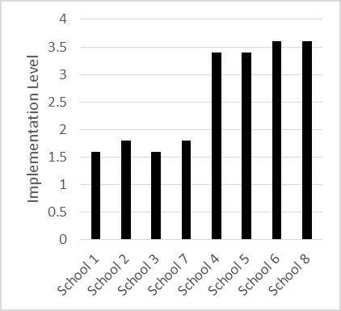
Variation in Implementation Fidelity

Slide 6
Did LT “work” at your school?
I think LT gave us some great ideas but I don’t feel they were completely implemented. I’m not sure other staff really understood what we were hoping to achieve
I think that as a school we have many more structures in place that help us to listen to each other and build trust. These structures were learned in LT and they are really helping us change

Slide 7
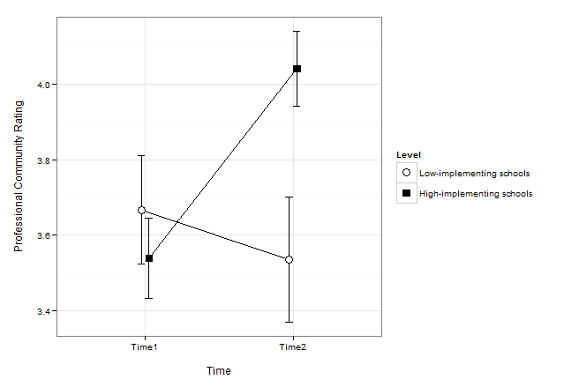
Findings: Professional Community

Slide 8
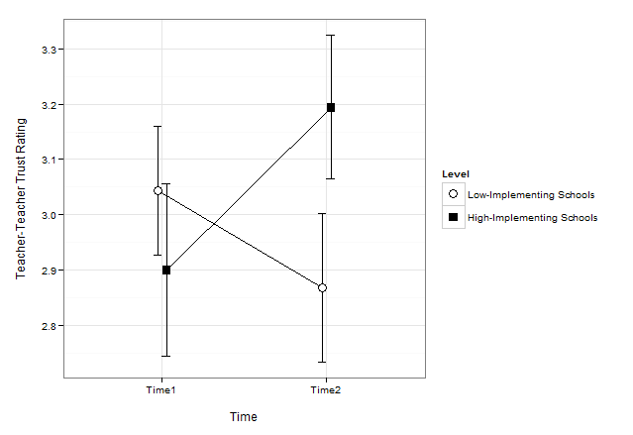
Findings: Teacher-Teacher Trust

Slide 9
How do you become a high-implementing school?

Slide 10
The 3 Ps of planning
Choosing an SEL program to implement

Slide 11
Principles
Notes:
“We believe” statements
We believe that it is important for all students and adults to feel safe here.
As a school, what are your beliefs about social emotional learning (SEL)?
What aspects of SEL are especially important to you?
What aspects of SEL are especially important for students at your school?

Slide 12
Practices
Notes:
Think about the practices that emanate from the principles described above. What practices need to be part of an SEL program that you use in your school?

Slide 13
People
Notes:
Who is going to be in charge of implementing the SEL program in your school? (Should be a group of people).
How will these people be chosen? How will this selection be explained to the rest of the staff?
Are these people trusted by the rest of the staff (perceived to be caring, respectful, competent, and full of integrity)?
How will this group build and maintain trust with the rest of the faculty?

Slide 14
Relational Trust
Social Respect
Personal Regard
Role competence
Integrity

Slide 15
Framing the PIC

Slide 16
Framing the PICture
Purpose | What is the purpose of the program? How is this purpose related to your school goals and vision?
Introduction | How will you explain the program to the rest of the staff? How will you explain why your school is participating in the program?
Commitment | How much time per week/month will you devote to program activities? What will this look like? (Make a schedule!) Who will be responsible for making sure you keep this commitment? How will you refresh and renew your commitment to the program?

Slide 17
Key points
Building and maintaining trust is of utmost importance!
Remember the 3 Ps of Planning
Principles
Practices
People
Before implementing, take time to frame the PIC
Purpose
Introduction
Commitment

Slide 18
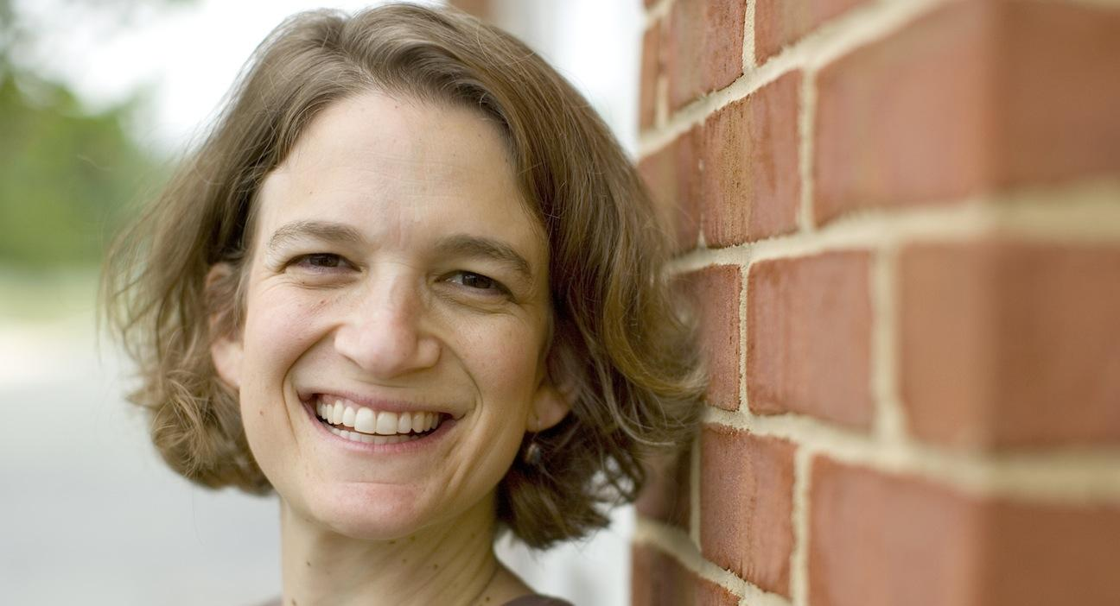
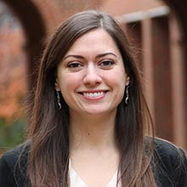
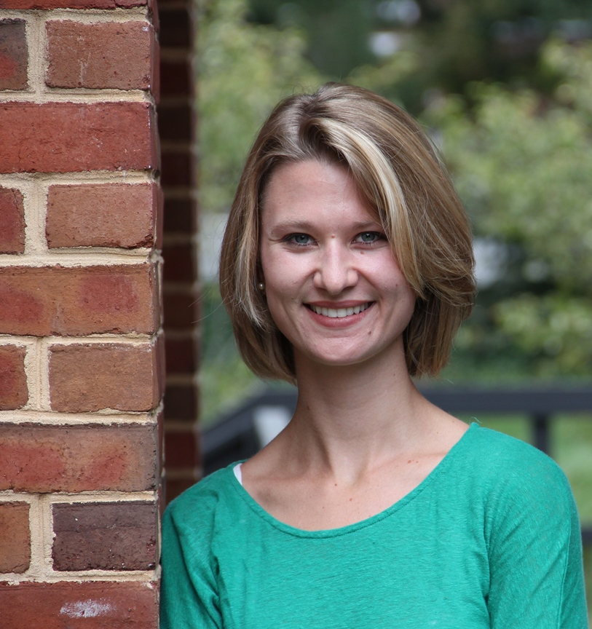
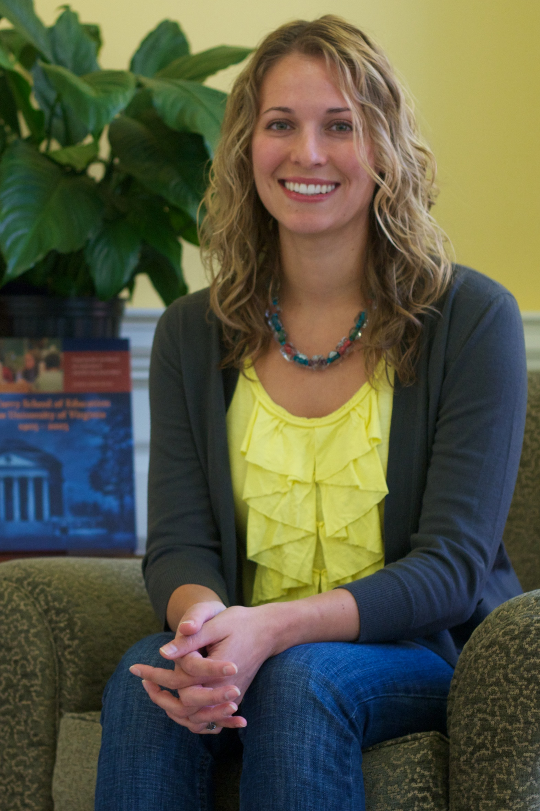
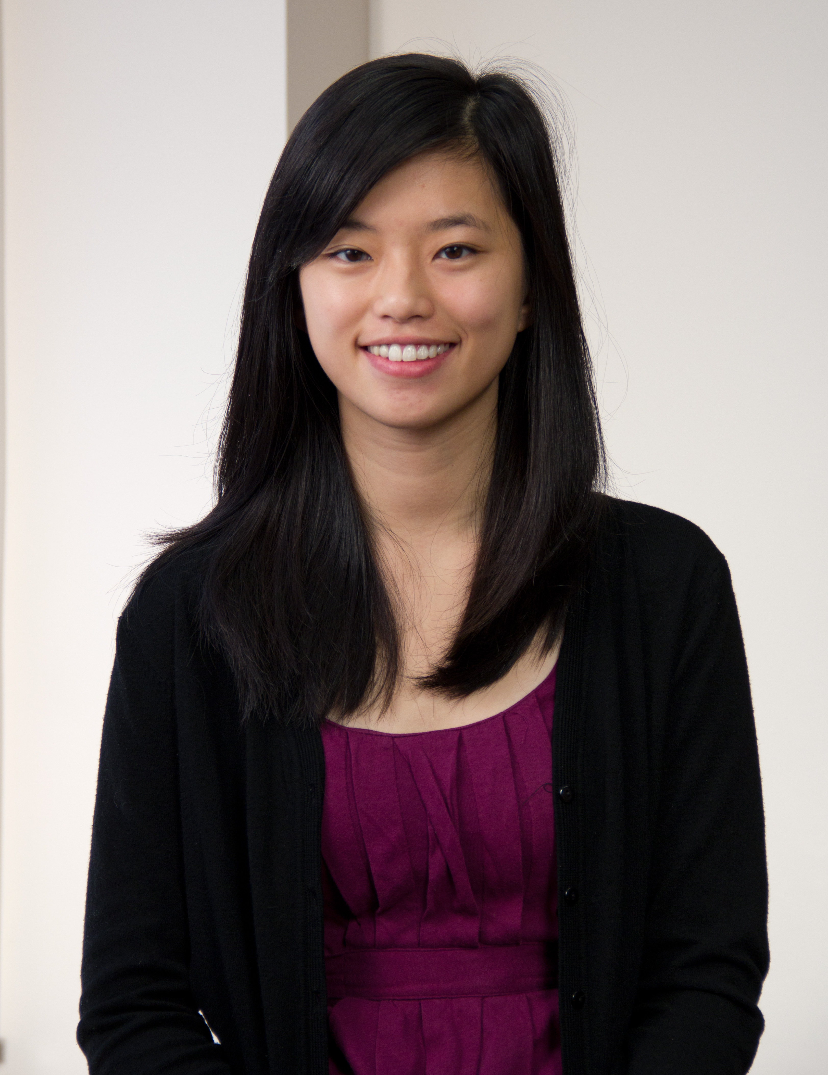
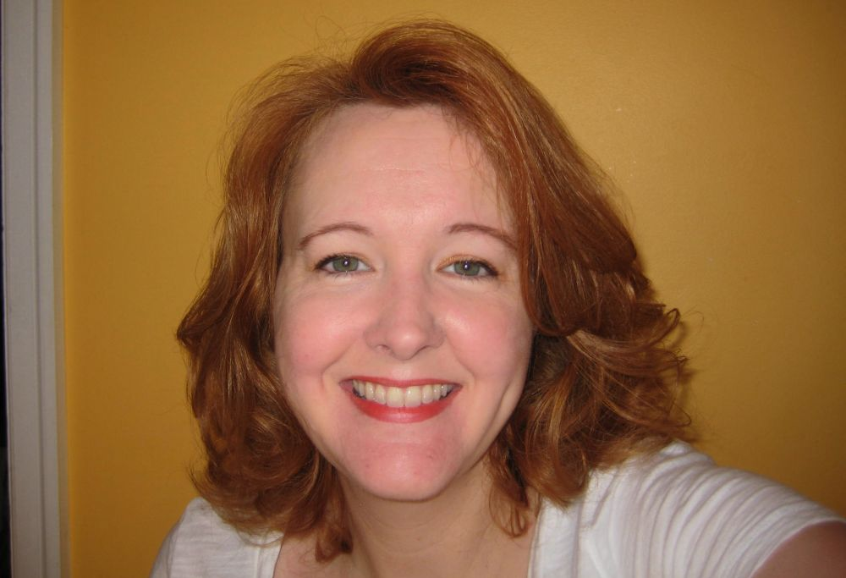
Who we are:
Social Development Lab at UVA
(http://www.socialdevelopmentlab.org/)
Led by: Dr. Sara Rimm-Kaufman
Dr. Lia Sandilos
Holland Banse
Julie Thomas
Micela Leis
E-mail: ml3kc@Virginia.edu
Carol Paxton
Michelle Ko

Slide 19
The research reported here was supported by the Institute of Education Sciences, U.S. Department of Education, through Grant #R305B090002 to the University of Virginia. The opinions expressed are those of the authors and do not represent views of the Institute or the U.S. Department of Education. Huge thanks to: Social Development Lab (Dr. Sara Rimm-Kaufman, Lia Sandillos, Carol Paxton, Julie Broderick, Michelle Ko); Leading Together Developers (Chip Wood, Pamela Seigle, Lisa Sankowski)

