Slide 1
Social Emotional Learning and the Brain: Why Emotional Learning is Essential for Academic Success
Meg Benningfield, MD
Assistant Professor of Psychiatry and Pediatrics
Vanderbilt University School of Medicine

Slide 2
Key points for today’s discussion
The way the brain is wired makes it impossible to completely dissociate “cognitive” from “emotional”.
Emotion regulation skills develop with brain maturity and can be promoted through direct instruction, behavior modeling, and providing a safe, predictable environment.
During adolescence the “emotional brain” has greater influence over the “cognitive brain” than in childhood or adulthood.
Specific educational strategies to address emotional learning can promote greater academic achievement.

Slide 3
What is emotion?

Slide 4
Emotion = biologically driven, automatic, coordinated response to stimulus SUBJECTIVE: feeling; cognitive representation OBJECTIVE: physiological change; behavior

Slide 5
What is the function of emotion?

Slide 6
Emotions serve the purpose of interpreting sensations and direction actions to maintain homeostasis.

Slide 7
Emotions limit sensory input attribute salience direct behavior

Slide 8
The brain is divided into regions with specialized functions.

Slide 9
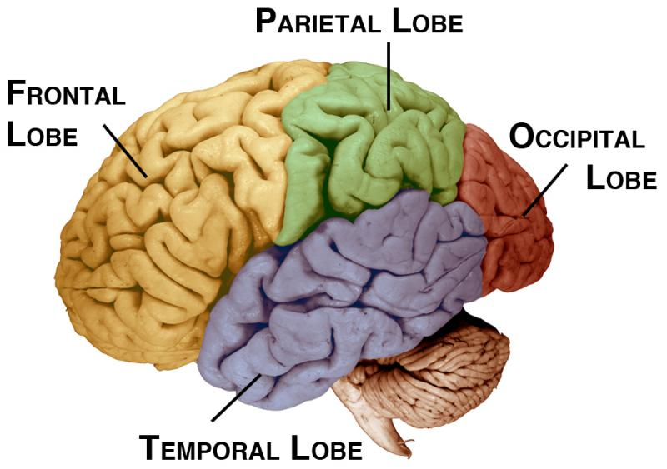
anatomical lobes
of the brain

Slide 10
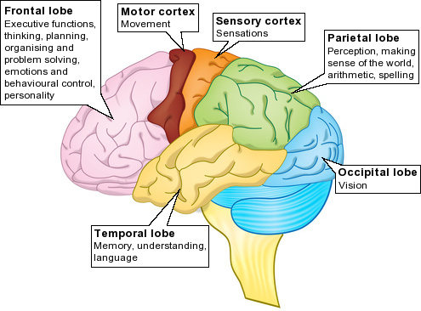

Slide 11
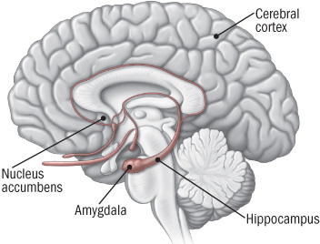
Emotional control regions are deep in the center of the brain

Slide 12
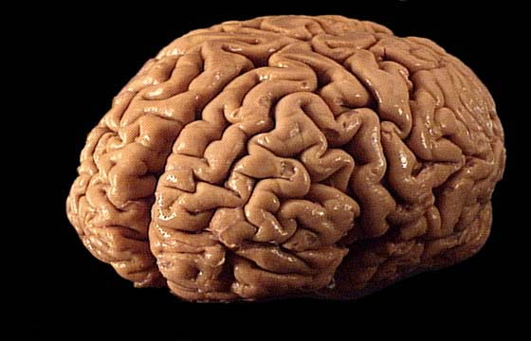
Your brain weighs only about 3 pounds.
It houses about 1 billion neurons.
Each neuron communicates with up to 10,00 other neurons—
resulting in up to 1000 trillion connections!

Slide 13
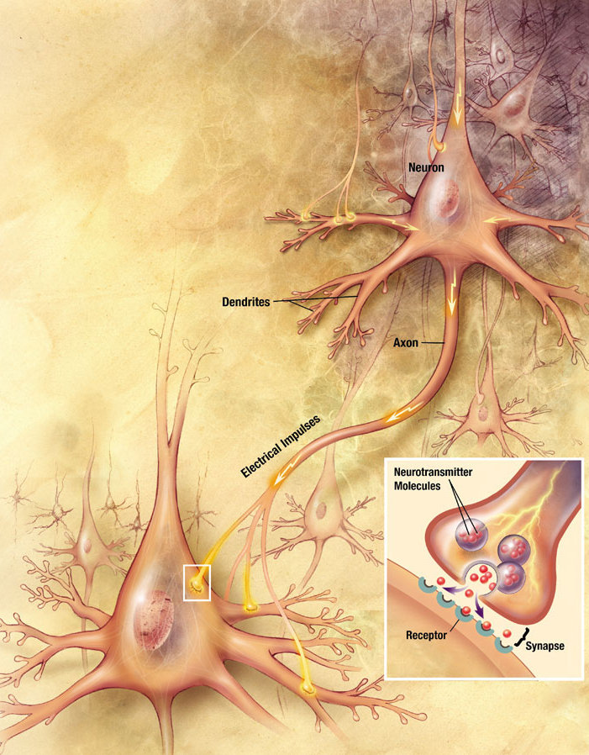
https://sitn.hms.harvard.edu/sitnflash_wp/2011/01/issue86/

Slide 14
Dopamine is the brain’s “salience” signal
Tells the organism what is important in the environment
Promotes goal-directed behavior
Promotes general activation
Is essential for learning associations – REWARD LEARNING
Koob and Volkow 2010 Neuropsychopharm 35: 217-238
Notes:
3) (adaptive capabilities and vigor or a response)

Slide 15
What motivates you?

Slide 17
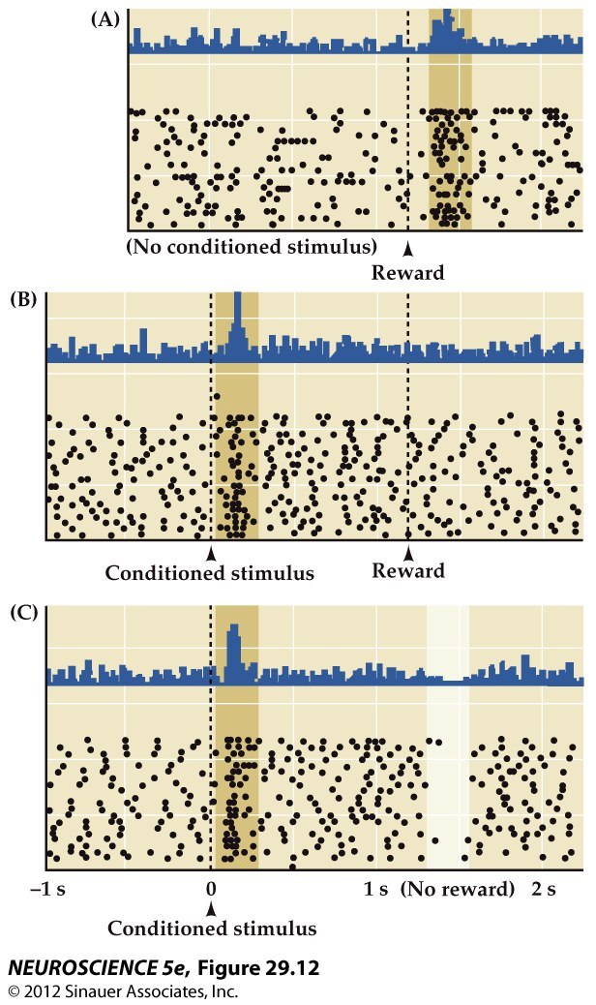
VTA dopamine signals deviations from predicted rewards
Intracellular recordings
Each line is a single neuron
Each dot is an action potential
Histogram at top (in blue) summarizes the data points

Slide 18
Our habits influences how we experience reward

Slide 20
What emotions do students associate with school?

Slide 21
“Cognitive” regions cannot function effectively without intact function in brain emotion centers.

Slide 22
Patients with injuries in brain emotional centers cannot apply social knowledge

Slide 23
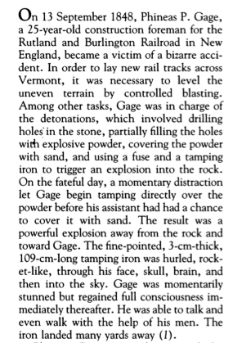
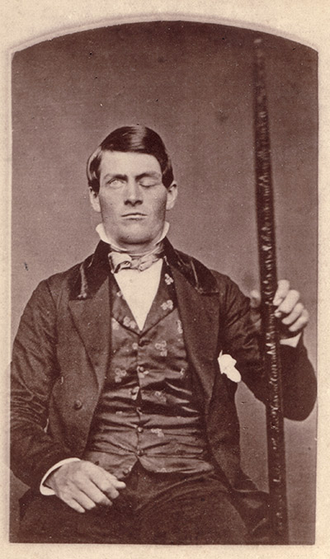

Slide 24
We are primed to focus on the negative to avoid threat. Students overwhelmed by emotion cannot engage rational centers.

Slide 25
Some good news…
Emotion regulation develops naturally with maturation of the brain’s frontal lobe
Emotion regulation is a skill that can be learned
direct instruction
modeling
providing a safe, predictable environment

Slide 26
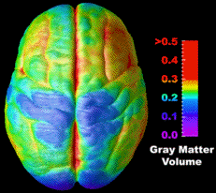
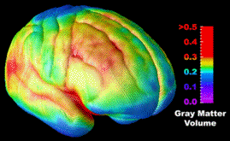
After about age 6, the brain matures
primarily by pruning synapses.
If you don’t use it, you may lose it!

Slide 27
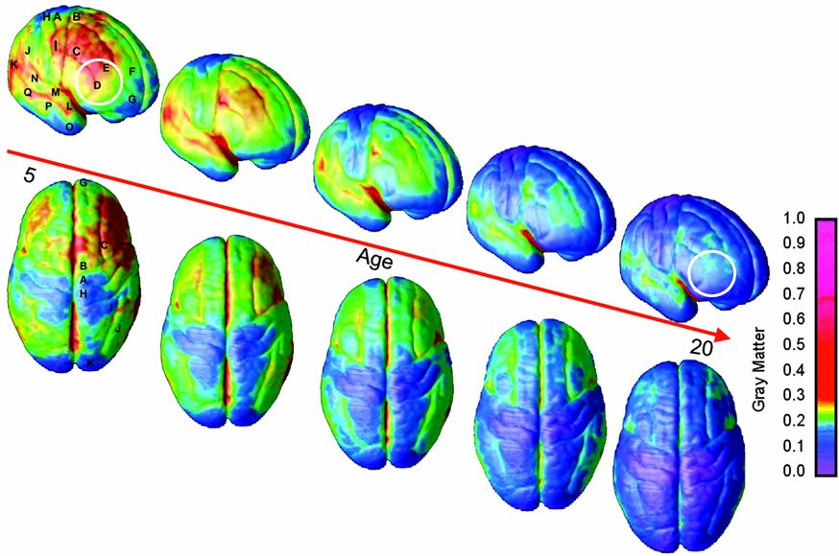
Gogtay, Giedd, et al. Proc. Natl. Acad. Sci., 2004

Slide 28
Even when we posses great skills, context influences how we use them; successful regulation

Slide 29
When The Lights Go Out
The World Eats Junk
https://eatery.massivehealth.com/
Notes:
Iphone app collects data from 7.68 million responses in 50 countries over 5 months

Slide 30
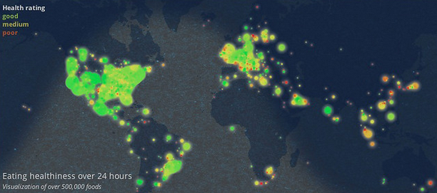
7 am

Slide 31
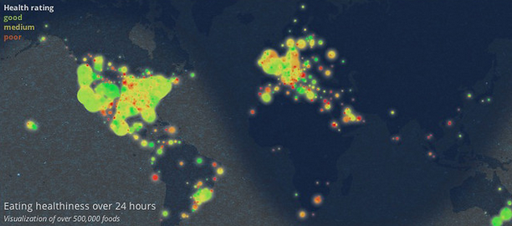
12 pm

Slide 32
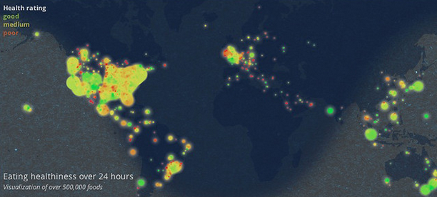
4 pm

Slide 33
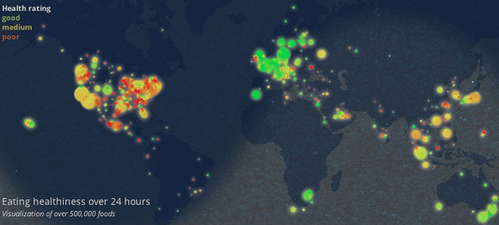
10 pm

Slide 34
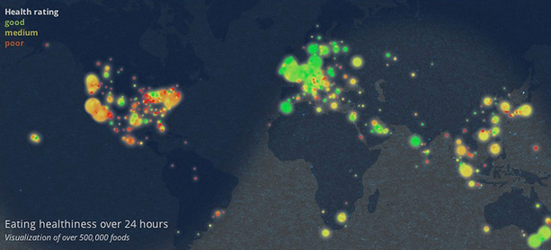
11 pm

Slide 35
As adults with solid emotion regulation skills, we must attend to our own needs and model good decisions

Slide 36
Our habits can
protect us from
poor decisions

Slide 37
Adolescence is a time of increased vulnerability

Slide 38
Inhibitory control and reward drive are imbalanced during adolescence
Casey& Jones 2010 JAACAP 49: 1189-1201
Casey& Jones 2010 JAACAP 49: 1189-1201

Slide 39
Up to 20% of students will experience symptoms of depression, anxiety, or impulsivity that disrupt learning.

Slide 40
Discussion of Classroom Strategies

Slide 41
Discussion of Classroom Strategies
Humans focus on the negative
Development occurs through synaptic pruning
Adolescence are driven by emotions
Peers hold greater influence in adolescence

Slide 42
Key points for today’s discussion
The way the brain is wired makes it impossible to completely dissociate “cognitive” from “emotional”.
Emotion regulation skills develop with brain maturity and can be promoted through direct instruction, behavior modeling, and providing a safe, predictable environment.
During adolescence the “emotional brain” has greater influence over the “cognitive brain” than in childhood or adulthood.
Specific educational strategies to address emotional learning can promote greater academic achievement.

Slide 43
Thank you!
meg.benningfield@vanderbilt.edu

