Slide 1
Welcome! As you get settled, please write your answers to this question on your plate: What are the things on your mind (personal and professional) as you walk into school each day?
Notes:
TAMARA

Slide 2
Teachers who can recognize, understand, label, express, and regulate emotions demonstrate:
More
Patience
Empathy
Healthy Communication
Safe Learning Environment
Less
Burnout
Source: Brackett, Palomera, Mojsa, Reyes, & Salovey (2010).
Notes:
TAMARA
Source: http://www.scusd.edu/sites/main/files/file-attachments/social_and_emotional_learning.pdf

Slide 3
Integrating Social & Emotional Learning with the Tennessee State Standards
Tennessee Center for Safe and Supportive Schools
Tamara Fyke
Brian Ketner
Notes:
TAMARA

Slide 4
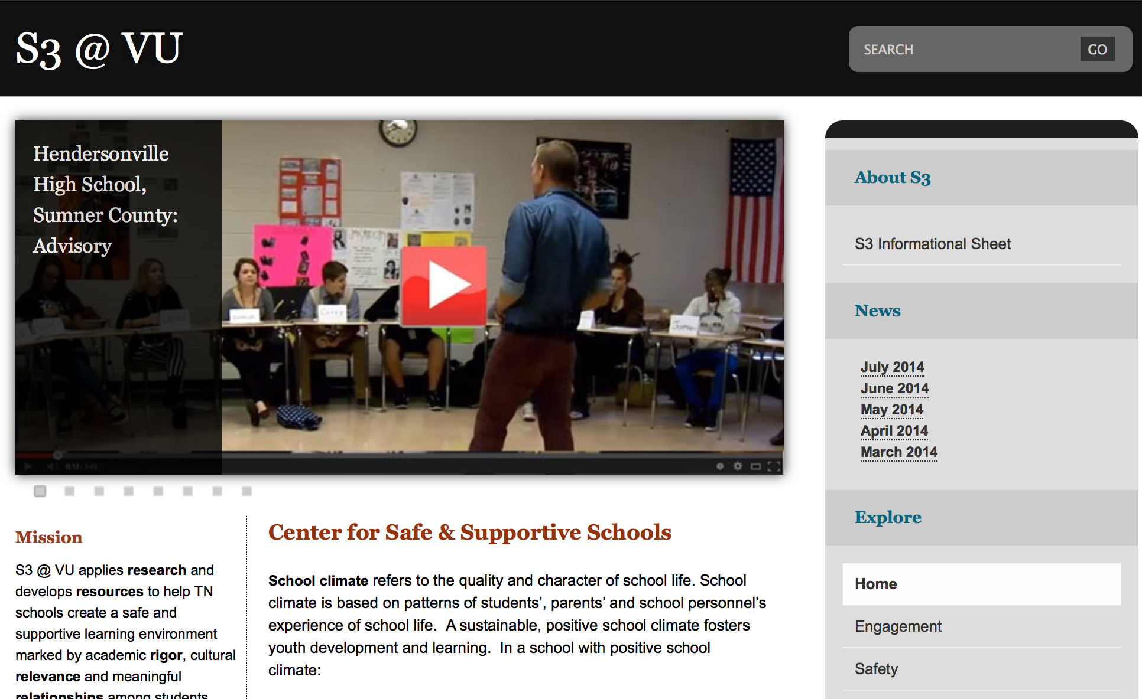
Notes:
TAMARA

Slide 5
Comprehensive Social-Emotional Learning (SEL)
School-Wide Efforts
Violence
Prev
Character-related Ed
Programs without a Common Framework
Sex Ed
Academic Skills
Families
Substance
Use Prev.
Health Ed
Service Learning
Community Involvement
Notes:
MAURY 2:45 – 2:50
Get a sense of who is in the room.
What trends/initiatives have you seen?
Give context for SEL and this presentation.

Slide 6
Comprehensive Social-Emotional Learning (SEL)
Comprehensive SEL
A Common Framework Provides Synergy
Sex Ed
Violence
Prev
Health Ed
Academic Skills
Substance
Use Prev.
Service Learning
Character-related Ed
SCHOOL-FAMILY-COMMUNITY PARTNERSHIPS
Notes:
MAURY 2:45 – 2:50

Slide 7
What is Social & Emotional Learning?
SEL is the process of acquiring and applying the knowledge, attitudes, and skills to:
understand and manage emotions
set and achieve positive goals
feel and show empathy for others
establish and maintain positive relationships
make responsible decisions
Source: www.casel.org/social-and-emotional-learning
Notes:
BRIAN

Slide 8
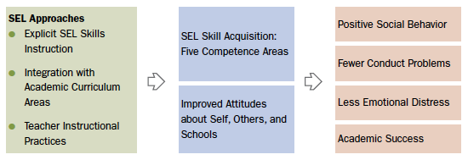
Benefits of SEL
Source: http://www.casel.org/social-and-emotional-learning/outcomes
Notes:
BRIAN

Slide 9
Why is SEL important?
INCREASED Achievement
Attitudes
Behavior
Social Skills
Emotional Skills
DECREASED Conduct Problems
Emotional Distress
Source: Durlak et al. (2011)
Notes:
BRIAN
- Academic achievement (11 percentile points)
- Attitudes toward self and others
- Positive social behaviors
This is true for:
ALL GRADES (K-12)
ALL SETTINGS (urban, rural, and suburb)
ALL SCHOOL TYPES (serving ethnically and racially diverse populations)
(See page 5 in “Teaching the Whole Child”)

Slide 10
Student learning is enhanced when teachers integrate social-emotional competencies with academic learning.
INCREASED Motivation
Commitment
Attendance
Graduation
DECREASED Misbehavior
Suspensions
Retention
Source: Elias (2004)
Notes:
BRIAN
Emphasize the INTEGRATED part
(See page 5 in “Teaching the Whole Child”)

Slide 11
What is on your students’ plates when they come to school?
Notes:
TAMARA
What do you do in your schools? What curriculum, programs, extracurriculars, athletics, etc. What are some of the underlying things students need to be successful in any of these? (classes, tests, student clubs, sports, discipline, relationships)

Slide 12
So, what do we serve students?
“Social Emotional Learning is the plate upon which all other curriculum should be served.”
– Lori Paisley, Executive Director of Coordinated School Health
Career/Tech Ed
Related Arts/P.E.
Tennessee State Standards
RTI²
PBIS
Extracurriculars
Social Emotional Learning
Notes:
TAMARA

Slide 13
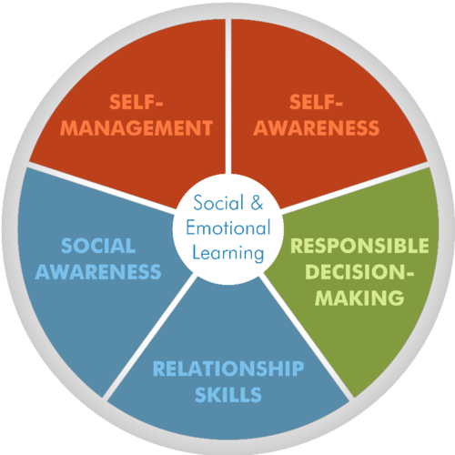
SEL Core Competencies
Notes:
BRIAN

Slide 14
SEL Core Competencies
In your pairs, review your competency and create a picture, poster, or mini skit that:
Summarizes the competency
Shows it in action
Notes:
BRIAN

Slide 15
What skills, competencies, and mindsets do students need to master Tennessee State Standards?
Notes:
BRIAN
Capture on chart paper?
More rigorous math: need to regulate frustration, persevere {SEL competency: self-awareness and self-management}
Citing more complex texts: know what they don’t understand (self-aware) and know how to ask for help (self-manage)
More class discussions and group work: communication and relationships (social awareness, relationships)

Slide 16
The Integration
SEL + TN State Standards
WHAT we’re learning
CONTENT
HOW we’re learning
PROCESS
Notes:
BRIAN

Slide 17
Practices that Promote SEL
Social Teaching Practices
Warmth & Support
Teacher Language
Responsibility & Choice
Student-Centered Discipline
Instructional Teaching Practices
Cooperative Learning
Classroom Discussions
Self-Assessment & Self-Reflection
Balanced Instruction
Academic Press & Expectation
Competence Building
Source: Center on Great Teachers and Leaders at
American Institutes for Research (2014).
Notes:
TAMARA
Winter clothes = warmth
Dictionary = teacher language
Spinner/menu = Responsibility and choice
Shovel = student ctrd discipline
Ball = cooperative learning
Cups/string = class discussion
Journal = self-assess/reflect
Bundle (book, paint, calc) = balanced instruction
Ruler/clock = academic press
Hammer = Competence building

Slide 18
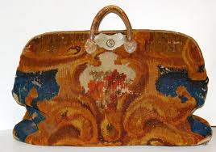
What’s In Your Bag?
Notes:
TAMARA
Winter clothes = warmth
Dictionary = teacher language
Spinner/menu = Responsibility and choice
Shovel = student ctrd discipline
Ball = cooperative learning
Cups/string = class discussion
Journal = self-assess/reflect
Bundle (book, paint, calc) = balanced instruction
Ruler/clock = academic press
Hammer = Competence building

Slide 19
Practices that Promote SEL
Social Teaching Practices
Warmth & Support
Teacher Language
Responsibility & Choice
Student-Centered Discipline
Instructional Teaching Practices
Cooperative Learning
Classroom Discussions
Self-Assessment & Self-Reflection
Balanced Instruction
Academic Press & Expectation
Competence Building
Source: Center on Great Teachers and Leaders at
American Institutes for Research (2014).
Notes:
TAMARA
Winter clothes = warmth
Dictionary = teacher language
Spinner/menu = Responsibility and choice
Shovel = student ctrd discipline
Ball = cooperative learning
Cups/string = class discussion
Journal = self-assess/reflect
Bundle (book, paint, calc) = balanced instruction
Ruler/clock = academic press
Hammer = Competence building

Slide 20
Blueprint
Notes:
BRIAN
Everyone helps participants

Slide 21
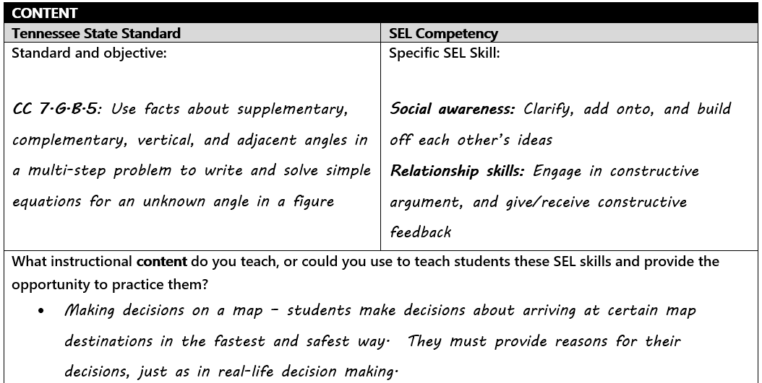
Notes:
BRIAN
Everyone helps participants

Slide 22
SEL Core Competencies
Notes:
(Just in case we need it here)

Slide 23
www.gtlcenter.org/sel-school
Notes:
Just note as a valuable resource

Slide 24
Thank you!
Questions
Resources
Pick up resources in the back
Email Tamara (tamara.fyke@vanderbilt.edu)
Evaluations
Notes:
TEAM 3:25 – 3:30

Slide 25
Tennessee Center for Safe and Supportive Schools
Dr. Maury Nation Director maury.nation@vanderbilt.edu
Tamara Fyke Program Manager tamara.fyke@vanderbilt.edu | Brian Ketner Technical Assistance Coordinator brian.t.ketner@vanderbilt.edu
www.vu.edu/s3 | www.safeschoolstn.org
THANK YOU!

Slide 26
References
Brackett, M. A., Palomera, R., Mojsa, J., Reyes, M., & Salovey, P. (2010). Emotion regulation ability, job satisfaction, and burnout among British secondary school teachers. Psychology in the Schools, 47, 406-417.
Center on Great Teachers and Leaders at American Institutes for Research. (2014). Teaching the whole child: Instructional practices that support social-emotional learning in three teacher evaluation frameworks (Revised ed.). Washington, DC: Nicholas Yoder. Retrieved from: http://www.gtlcenter.org/sites/default/files/TeachingtheWholeChild.pdf
Durlak, J.A., Weissberg, R.P., Dymnicki, A.B., Taylor, R.D., Schellinger, K. (2011) The impact of enhancing students’ social and emotional learning: A meta-analysis of school-based universal interventions. Child Development: 82(1), 405-432.
Durlak, J.A., Weissberg, R.P., & Pachan, M. (2010). A meta-analysis of after-school programs that seek to promote personal and social skills in children and adolescents. American Journal of Community Psychology, 45: 294-309.
Elias, M. J. (2004). Strategies to infuse social and emotional learning into academics. In J. E. Zins, R. W. Weissberg, M. C. Wang, & H. J. Walberg (Eds.). Building academic success on social and emotional learning: What does the research say? (pp. 113–134). New York: Teachers College Press.

